Slide 1
Affordable Care Act Goals
Expanded coverage options
Expensive proposition
Law dealt with expansion, offset, and policy issues outside of those under marketplace.

Slide 2
ACA Accomplished Coverage
 | Covered Individuals 2010 | Covered Individuals 2017
Employer-Coverage | 150 million | 155 million
Medicaid | 40 million | 67 million 11 million made eligible for Medicaid by the ACA 51 million otherwise eligible 6 million CHIP
Non-Group Policies | 27 million | 24 million 15 million purchased through the Marketplaces 9 million purchased outside the Marketplaces
Uninsured | 50 million | 26 million (10% of population)

Slide 3
Financing the ACA
EXPENDITURES: Exchange Subsidies Medicaid Expansion
Less than 20 million covered lives receiving subsidies
Up to 15 million covered lives under Medicaid expansion
REVENUE: Medicare Cuts New Taxes
Roughly $500 billion from Medicare reductions
Roughly $500 billion from tax changes

Slide 4
White House Directives
Executive Order, “Minimizing the Economic Burden of the Patient Protection and Affordable Care Act Pending Appeal” and Chief of Staff’s Memorandum on Regulatory Freeze, issued January 20, 2017
exercise all authority and discretion available to them to waive, defer, grant exemptions from, or delay the implementation of any provision or requirement of the Act that would impose a fiscal burden on any State or a cost, fee, tax, penalty, or regulatory burden on individuals, families, healthcare providers, health insurers, patients, recipients of healthcare services, purchasers of health insurance, or makers of medical devices, products, or medications;
provide greater flexibility to States and cooperate with them in implementing healthcare programs; and
encourage the development of a free and open market in interstate commerce for the offering of healthcare services and health insurance, with the goal of achieving and preserving maximum options for patients and consumers.
Many questions surrounding how it will be implemented, but E.O. and Memorandum are limited to acting within the extent of existing laws.

Slide 5
State of Play
Phase I
Reconciliation Requiring 51 votes in Senate
Reconciliation budget levels
House and Senate to report
Phase II
Administrative Changes
Sec. Price nominated and confirmed
Regulatory changes to reduce certain burdens
Phase III
Additional Legislative Reforms
Requiring 60 votes in Senate
Identify bipartisan package of changes to underlying law and other health care changes

Slide 6
Current Issues
Administration Activities
House package (3/2):
Repeal all taxes (except “cadillac” tax); tax credit (rather than subsidy); Medicaid expansion preserved through 2020 then individuals can stay on with coverage; Medicaid federal share“capped” payment for five populations (low-income (expansion, non-expansion),children, disabled, aged); State Innovation Grants.
Senate package evolving
No repeal without a replace.
Financing an obstacle to ensure 20 million new covered lives are not disrupted.

Slide 7
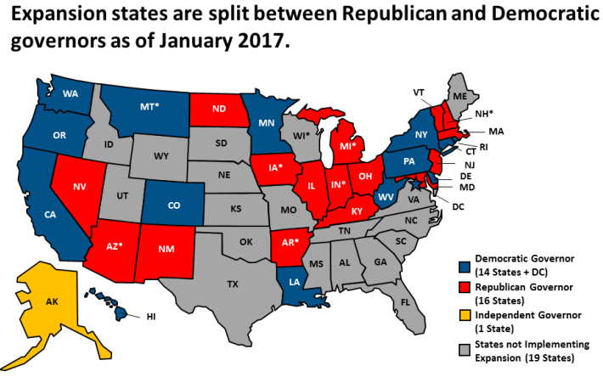
Medicaid
Concerned with expansion funding continued
Concerned with block grant/per capita cap

Slide 8
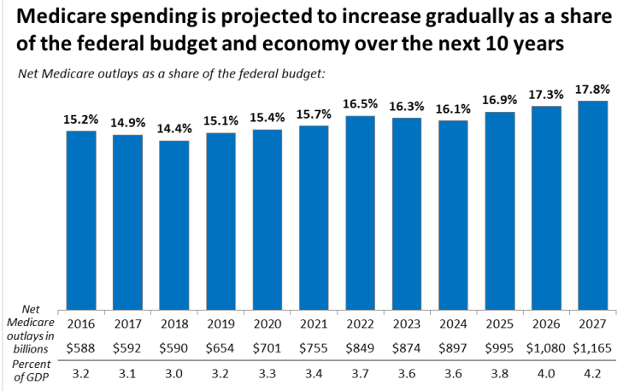
Medicare Cuts
Productivity reductions
DSH payments

Slide 9
Issues of Concern
HHGM (section 3131 of ACA)
PCRD
COP (delay??)
Other issues

