Slide 1
How will the new Administration affect home health services?
Nancy Taylor/Jeff Alberg
Greenberg Traurig
December 8, 2016

Slide 2
Outline of Issues
Affordable Care Act
What is “repeal and replace”
What is currently under consideration and timing
Impact on: employers, insurers, providers
Home Health Care
Medicare
Updates – HHGM, PCRD, VBP, CMMI
Medicaid
Focus on expansion; two-year timetable?
Governors/States

Slide 3
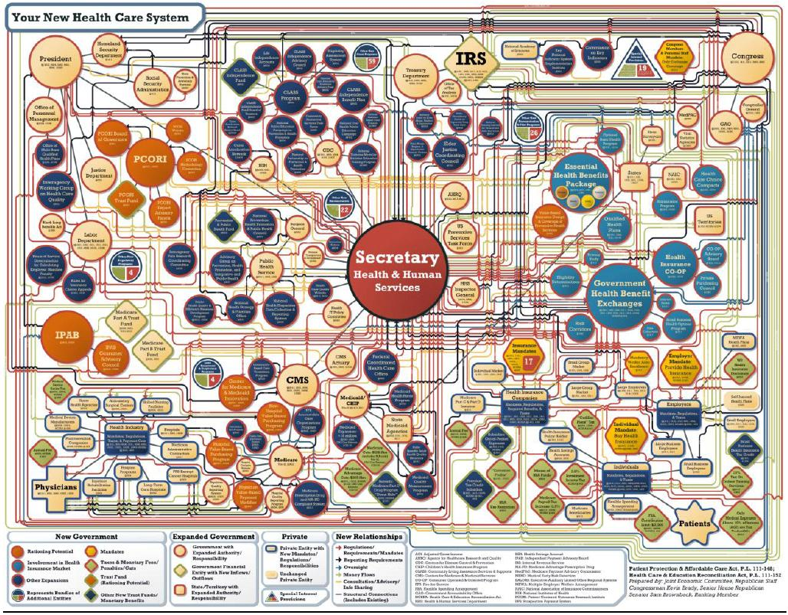

Slide 4
Affordable Care Act
20 million Americans more are covered in 2016/30 million still uncovered
Growth in ESI, Medicaid and Exchange Marketplace
Complexities in obligations for employers, insurers, providers
Greater demand in services (but not in the hospital)
New Payment models

Slide 5
ACA Politics
“Repeal and Replace”
Reconciliation process in detail
Replacement plans
“A Better Way”- Speaker Ryan
“Empowering Patients First Act” – Rep. Price (R-GA)

Slide 6
Reconciliation Process
Process encumbered by Senate rules – taxing or spending direct authority
Reconciliation for 2016 Budget
Reinsurance, Risk Corridor, Risk Adjustment – no expenditure or fees collected after 1/1/2016.
Repeal for one or two or three years:
premium tax credit and cost sharing subsidies
Small business tax credit
Employer and individual mandate
Medicaid expansion (except States already expanded)
All taxes (Cadillac, insurance/pharma/devices, OTC, HSA, FSA limitations RDS subsidy, “chronic care tax”, Medicare tax increase, tanning tax, net investment tax.
See Republican Policy Paper outlining issues completely**
Replace based on consensus or majority or another Reconciliation bill

Slide 7
Affordable Care Act Provisions Not Repealed
Center for Medicare and Medicaid Innovation
Reductions in payment for providers
Various employer/insurer requirements
Quality Improvements
Fraud issues (nursing facilities and increased penalties)

Slide 8
Republican Themes on Replace
Ownership of health insurance.
Greater consumer awareness.
Equal tax treatment for employees/individuals.
Wellness programs.
Flexibility for self-insured plans.
Expand consumer accounts.
Greater state flexibility.
Insurance sales across-state-lines.
Medicaid block grant or per capita cap.

Slide 9
Rep. Price – Empower Patients First Act
Patients and their doctors make health care decisions without bureaucratic interference or influence.
Focus on affordability, accessibility, quality, innovation, choices, and responsiveness.
Tax credits for the purchase of coverage.
Individual health pools.
Expand health savings accounts.
Lawsuit abuse reforms.

Slide 10
What to Watch
Repeal? Replace? Timing.
Hospitals geared up on Medicaid.
Families USA geared up on ACA.
Regulatory oversight or hold on enforcement.
Senator Statements:
Senator Alexander, Collins
Senate 52-48 Republican Majority

Slide 11
Impact on Employers/Insurers/Providers
Watch for regulations to be “not enforced” or “rescinded” or ??
Employers will still have some stifling requirements: reporting (unnecessary), SBC, waiting periods, nondiscrimination rules, etc.
Insurers will still have MLR, rating reviews, bidding in 2018-2019 in Exchanges.
Providers, including home health, will face uncertainty, but many requirements may continue.
Employers want: flexibility; more freedom with HSAs (HRAs,FSAs) – large employers will not drop coverage

Slide 12
Federal Budget/Leadership
Budget Reconciliation
Watch for Trump Budget
Likely have a process in place
Health care spending growing faster than any other part of the current budget (5.1% rate of growth – MEI for Medicare programs around 2-3-1% productivity factor)
Leadership
Speaker Ryan a “policy” leader
Majority Leader McConnell a “political” leader
President-elect Trump a “transactional” leader

Slide 13
HHS Leadership
Rep. Price – discussion
Leadership at CMS
Signals greater cooperation with States
Majority Leader letter to Governors/Insurance Commissioners**

Slide 14
Post-Acute Care Providers
Fasting growing component of Medicare
LTAC, IRF, SNF, HH (acuity? Payment levels?)
Bundling? Value based purchasing? Impact Act Requirements (uniform tool to determine acuity and needs)
Yearly payment updates
Movement in Medicare toward Medicare Advantage.
SNFs highly dependent on Medicaid – LTTS MCO programs growing.

Slide 15
Physicians
MACRA
One hour presentation on the key elements of MACRA
Effective in 2017 – slow transition
Physicians go under either MIPS or APM
MIPS – four issues to report on: quality, use of EHR, costs (performance score), improvement activities
APM (alternative payment model) – quasi at-risk programs to receive payment for episode
Excludes physicians with less than x patient encounters and less than x billings (100, $100,000 – but signal more to come)
Part B Demonstration (later)
More MA/MCO

Slide 16
Prescription Drugs
Growing concern with the cost of biologics
FDA backlog for biosimilars (no real cost savings to consumers with competition yet)
Part B Demonstration
Modified the payment of Part B drugs in four ways to measure how to reduce incentives and price of drugs – proposed, not final
Part D – retain the non-interference clause
BIG PHARMA effort to get “value” in the equation

Slide 17
Medicare-Home Health Care
NO COP Final Rule Yet
Medicare Post-Acute Care VBP Act of 2015
Major rewrite with added complexity; HHA VBP retained
Some gains, some losses
Program would start in FY ’19 (CY ’20 for HHA)
Bill could be introduced soon

Slide 18
Pre-Claim Review Demonstration
Troubled implementation in Illinois
Affirmation rates are rising but problems remain…
Affirmations rates do not reflect MACs requiring frequent resubmissions
Affirmations have been very subjective

Slide 19
Home Health Groupings Model
HHGM technical report has been released
Groups episodes into payment categories based on patient’s diagnoses, patient’s functional status, admission source, and timing
Clinicians identify the types of patients they see
Uses diagnoses as the primary reason that home care is being provided with further refinements based on patient characteristics

Slide 20
Setup of HHGM
Each HH episode is categorized into different sub-groups within each of five categories
Timing
Referral source
Clinical groupings
Functional/cognitive level
Comorbidity adjustment
HHGM produces 128 different payment groups

Slide 21
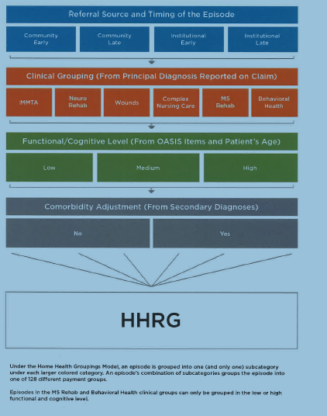
Setup of HHGM

Slide 22
HHGM- 30 Day Episodes
HHGM uses a 30 day period—not a 60 day episode like in current system
Episodes have more visits on average during the first 30 days compared to the last 30 days
Dividing a single 60 day episode into two periods allows payments to be more accurately apportioned
No impact to OASIS—an assessment would apply to two consecutive 30 days periods

Slide 23
Medicaid
Medicaid
Likely block grant and/or more ease in waiver process (can be done administratively)
Money is an issue – questions about how Congress/Administration will handle spending issues

Slide 24
Conclusion
Up to date on various changes occurring
State Councils in a good position to articulate to State and federal leadership on the dual role and the important purpose that HH plays in offered VALUED services

