Slide 1
Team Chair Orientation

Slide 2
About MHCA
Started as a council of the Minnesota League for Nursing
1970 – organized as the Assembly of Home Health Nursing Agencies
1989 – reorganized and incorporated as independent and non-profit corporation 501(c)6 - Minnesota HomeCare Association (MHCA)

Slide 3
Purpose of MHCA
MISSION
VISION
MHCA represents and supports Minnesota home care providers committed to high quality home care services.
MHCA will shape the home care landscape to improve and sustain quality home care services.

Slide 4
Board of Directors
OFFICERS
Jay Jones, Chair
Kim Olson, Vice Chair
Austin Figge, Treasurer
Jan Usset, Past Chair
DIRECTORS
Denise Edgett
Lisa Fowler
Linda Hespe
Susan Morgan
Andrea Jung

Slide 5
Board Roles
Govern the corporation
Policy and positions development
Strategic vision
Fiduciary – financial oversight
Bob Harris, CAE

Slide 6
Strategic Plan
Established by the Board of Directors
Guides the work of the organization

Slide 7
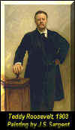
Every man owes a part of his time and money to the business or industry in which he is engaged.
No man has a right to withhold his support from an organization working to improve conditions….

Slide 8
Committees = MHCA Teams

Slide 9
Committees of the Board
Executive Committee
Nomination Committee
Finance Committee
Standing/Ad-Hoc Committees and Teams

Slide 10
2016-17 Standing Teams

Slide 11
2016-17 Advisory Groups & Task Forces
Education Advisory Group
Physicians Advisory Group
Workforce Task Force

Slide 12
Clinical Quality
Chair: Mary Fraser
Vice Chair: Kristy Husen
Nurse Consultant: Connie Dreyer
Responsibility: Reviews and recommends direction on issues relating to Outcome Based Quality Improvement (OBQI), adverse event reports, quality assurance and use of reports and data to improve quality.

Slide 13
Legislative
Chair: Vicki Gerrits
Responsibility: Review, track and participate in state and federal legislative issues related to home care. Coordinate member grassroots engagement and provide applicable information and resources to members.

Slide 14
MA (DHS Liaison)
Chair: Jane Vujovich
Responsibility: Stays current on MN health care programs and state payment issues. Develop a relationship with DHS and help members understand DHS’ role with various home care issues.

Slide 15
Medicare (Federal Regulatory and Payment)
Chair: Nikki Gruis Diekmann
Responsibility: Remain current on the Medicare home health benefit set, reimbursement and regulatory issues.

Slide 16
Membership
Chair: Katie Troumbly
Responsibility: Serve the needs of MHCA members by soliciting feedback from members; recommending goals and strategies to retain current members and recruit new members. Assess membership trends and dues structure. This team acts as the “eyes and ears” of the membership and facilitates member engagement.

Slide 17
Rehab
Chair: Alisha Miller
Responsibility: Develop resources and education that addresses best practices, standards and regulations for speech, physical and occupational therapies in the home health setting.

Slide 18
Survey & Regulatory Analysis (MDH Liaison)
Chair: Lisa Flynn
Nurse Consultant: Lores Vlaminck
Responsibility: Stay current on state licensure and Medicare certification compliance. Educate members on and develop tools for implementing state and federal rules and regulations. Develop a relationship with MDH and provide clarity for members regarding MDH’s role with various home care issues.

Slide 19
Board Liaison Role
Do…
Clarify for the committee board charge, expectation.
Serve as a resource.
Encourage progress and leadership.
Be prepared to update and clarify.
Don’t…
Dominate the meeting.
Lead the discussion.
Bring personal agenda.
Bob Harris, CAE

Slide 20
MHCA Board Liaison Role
Provide direction and guidance to ensure team remains focused on strategic priorities
Reports team activity at Board meetings
Communicate Board direction, requests, etc to Team Chair
Available for consultation

Slide 21
Power - Authority
Board is limited by the bylaws.
Committees are limited by the board charge or work assignment. (no freelancing in the committee- the board wants to know what you are doing.)
May not contract for the organization nor spend resources without explicit OK.
Bob Harris, CAE

Slide 22
Authority
Bylaws
Board/Chair’s Charge
Committee Mission
Bob Harris, CAE

Slide 23
Committees Have Value
Committees Produce Valuable Work Products (manuals, educational sessions, etc.)
Respect everyone’s time (members & staff)
Value time ($40 hours x 10 persons is a $400 contribution)
Travel time
Anticipate outcomes – what value will the committee add to the organization?
Query committee members – what resources do they bring to the table?
Bob Harris, CAE

Slide 24
General Committee Roles
Carry out tasks for board, advance the strategic plan, complete board charges.
Make recommendations to the board.
Work with/guide/resource to staff to implement programs.
Develop potential leaders.
Bob Harris, CAE

Slide 25
Adage
Committees Recommend
Boards Approve
Staff & Volunteers Implement

Slide 26
MHCA Teams
Working arms of the Association
Provide topical expertise
Develop member resources
Ensure relevant and timely information is shared with members

Slide 27
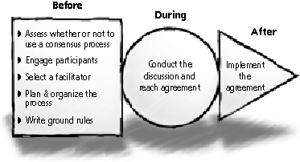
3 Parts to a Meeting
Before – Plan, Anticipate, Prepare
During – Effective Meeting, Tackle Work
After – Follow Through, Reports, Closure

Slide 28
Meetings Tips
Have a reason to meet.
Draft a good agenda – a flow of work.
Use staff and/or board liaison – utilize available resources.
Show appreciation to all volunteers.
Respect time. Respect ideas.
Take minutes or ask someone to record notes.
Use rules of order to stay on the agenda.

Slide 29
Role of the Chair
Diplomat.
Organizer/Scheduler/Agenda.
Firm but Gentle at Meetings.
Envision Outcomes.
Future Leader.
Manage Time and Self.
Be and enforce Accountability.
Bob Harris, CAE

Slide 30
Chairs’ Roles
Do…
Understand/explain the purpose.
Facilitate an effective meeting.
Share the credit.
Build leadership.
Craft an agenda/plan meeting.
Be a consensus builder.
Don’t
Dominate the discussion.
Bring pre-conceived, personal agendas.
Waste anybody’s time.
Start late.
Come unprepared.
Bob Harris, CAE

Slide 31
MHCA Chair Role
Develop and monitor team work, coordinating with staff liaison
Facilitate meetings
Assign minute taker
Encourage and motivate team members
Make appropriate assignments within team
Communicate with Board Liaison and other Team Chairs, as applicable
Track follow-up activity

Slide 32
Chair Responsibilities
Be familiar with Team Charge
Be familiar with Parliamentary Procedure
Be planful
Be timely with communications
Draft agenda for staff review
Use current template
Include conference call information
Send one week in advance
Assign minute taker
Ask: “What would be helpful for members?”

Slide 33
Policies/Procedures
Team Protocol
Anti-Trust
Penalty = $10 million

Slide 34
Confidentiality
Maintain confidentiality.
Support work of the board and committee.
Avoid antitrust.
Bob Harris, CAE

Slide 35
Minute Taker
Minutes Template
Date, place
List attendees
Brief overview of each agenda item, with minimal description if it provides valuable insight (historical purposes)
State motion exactly as worded
Do not include who made motion
Send Minutes to Staff Liaison or Annie

Slide 36
Making Proposals
Recommendation – Committee recommendation to the board when it involves policy or financial resource (staff or dollars). Not everything has to go to the board.
Action Item – Program, idea, suggestion to staff that can be undertaken without policy or financial adjustment.
Bob Harris, CAE

Slide 37
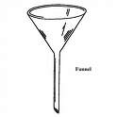
Committee “Filter”
Apply the filter to ensure the recommendation is favorably viewed by the board (six standards):
Bob Harris, CAE

Slide 38
Committee “Filter”
Is it within the assignment, scope, purpose of the committee?
Does it advance the purpose, vision, mission and strategic goals?
Does it best serve the members?
Bob Harris, CAE

Slide 39
Committee “Filter”
Consistent with governing documents?
Had input of board liaison and staff liaison?
Will it be understood by the board? (format, graphics, outcomes, ROI)
Bob Harris, CAE

Slide 40
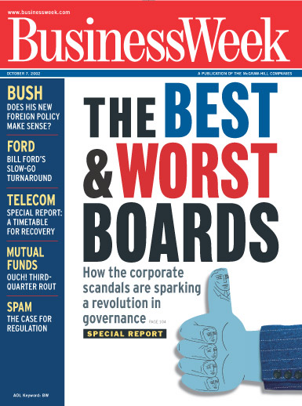
Effective Team Meetings
Clear Purpose
Fit within the Mission Statement
Advances the Board’s Strategic Goals
Meetings are Efficient
Member Value

Slide 41
Staff Liaison Role
Do…
Treat like a professional and valued resource.
Interface with other committees.
Give good direction.
Logistics resource.
Don’t…
Mistreat – make your secretary.
Make staff the fall-guy.
Fail to communicate.
Ignore calls and deadlines.
Bob Harris, CAE

Slide 42
Staff Liaison
Work with Team Chair (and Nurse Consultant, when applicable) to develop and monitor team work
Provide support and resources
Review meeting agendas prior to distribution
Provide input from staff perspective
Communicate information about team activities to other staff
Ensure minutes are emailed via listserv

Slide 43
Woodrow Wilson
``Congress in session is Congress on public exhibition…..whilst Congress in its committee rooms is Congress at work.''

Slide 44
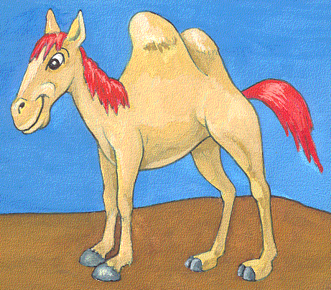
A camel is
a horse designed by a committee.

Slide 45
Questions/Discussion?

Slide 46
MHCA Thanks You!

