Slide 1
Board of Directors Orientation
2025

Slide 2
About MHCA
Started as a council of the Minnesota League for Nursing
1970 – organized as the Assembly of Home Health Nursing Agencies
1989 – reorganized and incorporated as independent and non-profit corporation 501(c)6 - Minnesota HomeCare Association (MHCA)
2020: 50th Anniversary

Slide 3
Members at a Glance
Agency Type | Membership % | # Members
Medicare Certified | 71% | 76
Comprehensive Licensed (Includes HCN) | 29% | 31
Basic Home Care/Other | 4% | 4
Hospice | 28% | 30
Palliative Care | 12% | 13
PCA | 23% | 26
Total Agencies MHCA Serves |  | 107
Notes:
Lauren

Slide 4
Members-at-a-Glance #2
Agency Description | Number of Members
Hospital Affiliated | 26
Nursing Home Based | 7
For-Profit | 42
Non-Profit | 24
Government/County | 7
Notes:
Lauren

Slide 5
Purpose of MHCA
MISSION
VISION
MHCA serves home care providers through advocacy, education, resources, and collaborations.
Home care services across Minnesota will be high-quality and sustainable.

Slide 6
MHCA Values
High Quality
Adaptability
Integrity
Equity
View Details

Slide 8
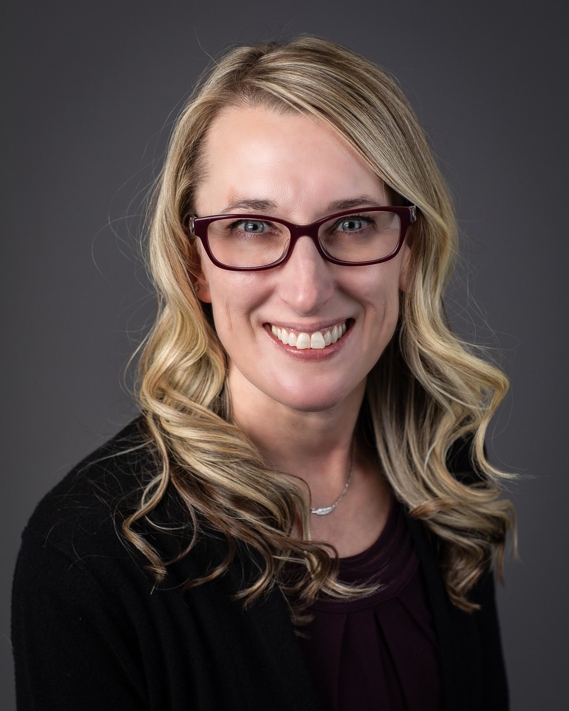
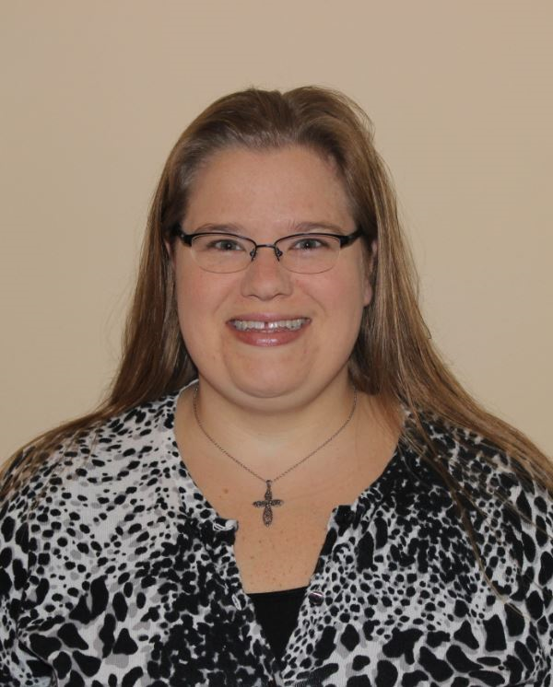
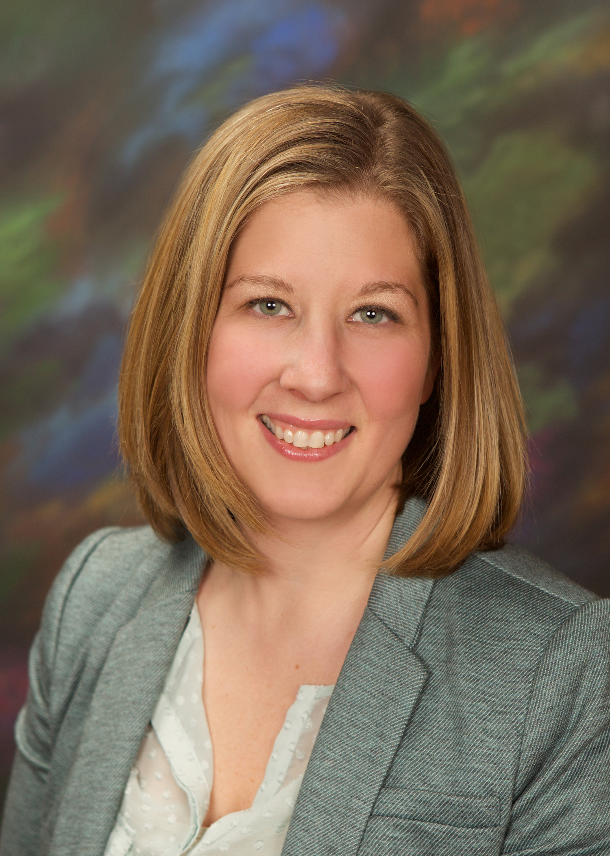
2025 Executive Committee
Kristy Husen
Chair
CentraCare Home Health & Hospice
Toni Diede
Vice Chair
NextStep Home Care, Inc.
Jaime Kummer
Secretary/Treasurer
River Valley Home Care

Slide 9
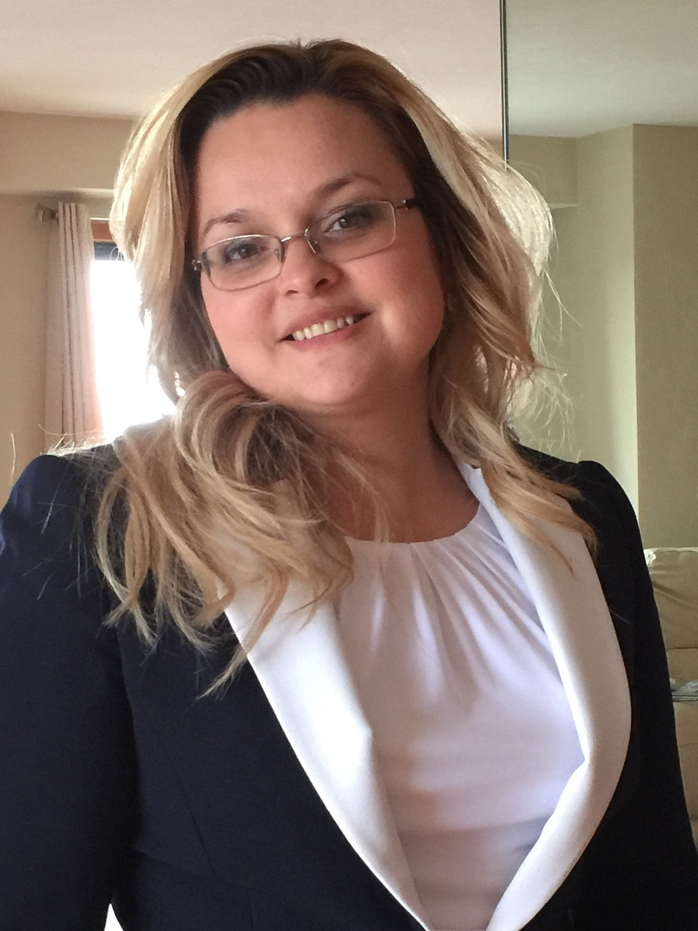
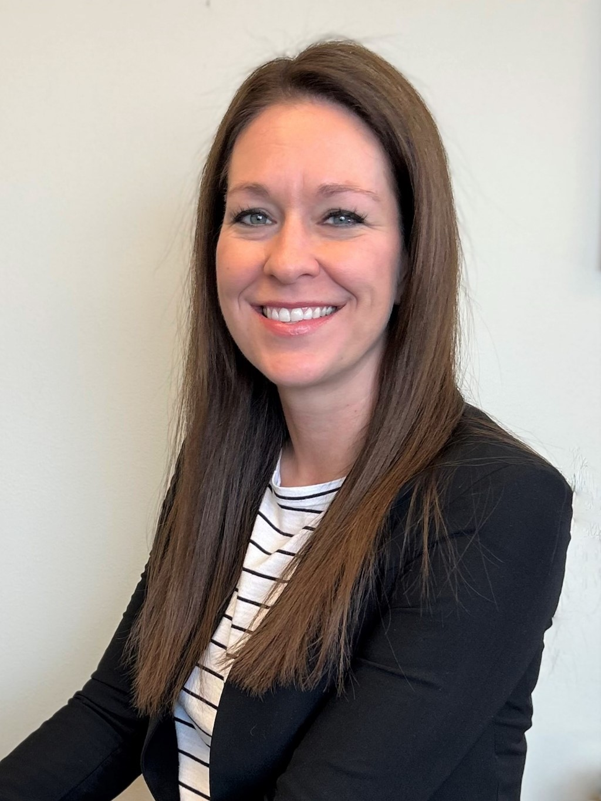
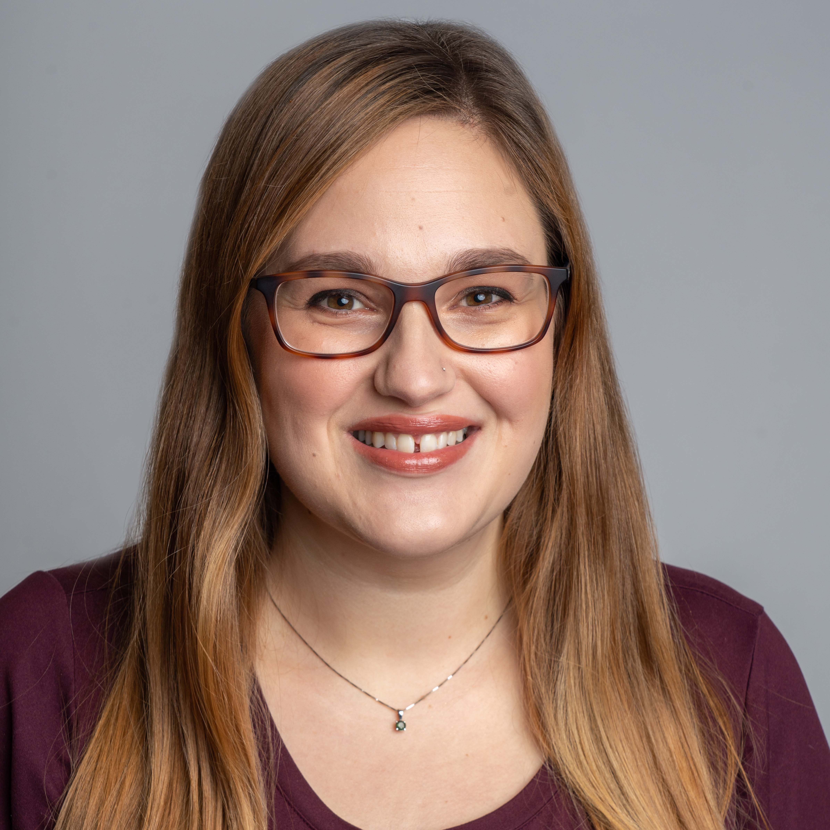
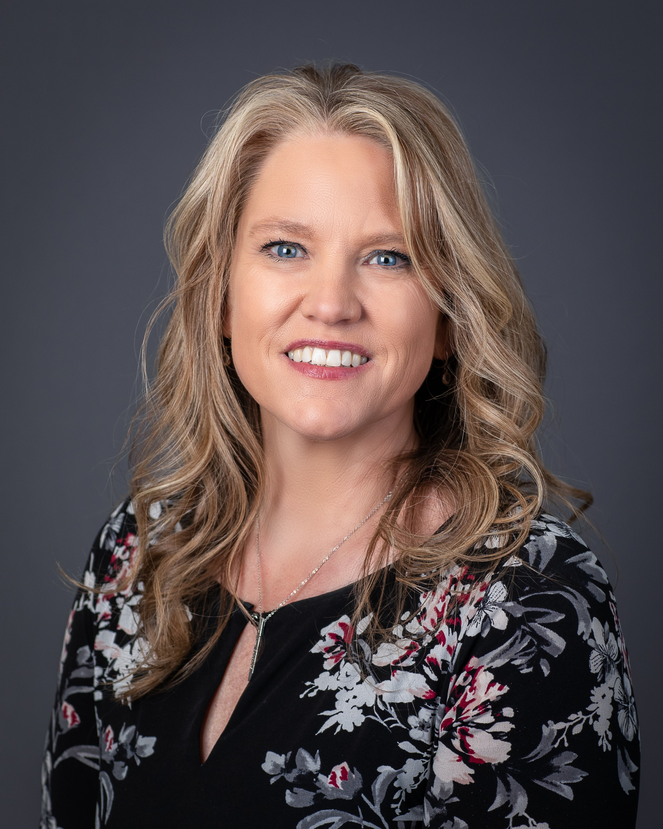
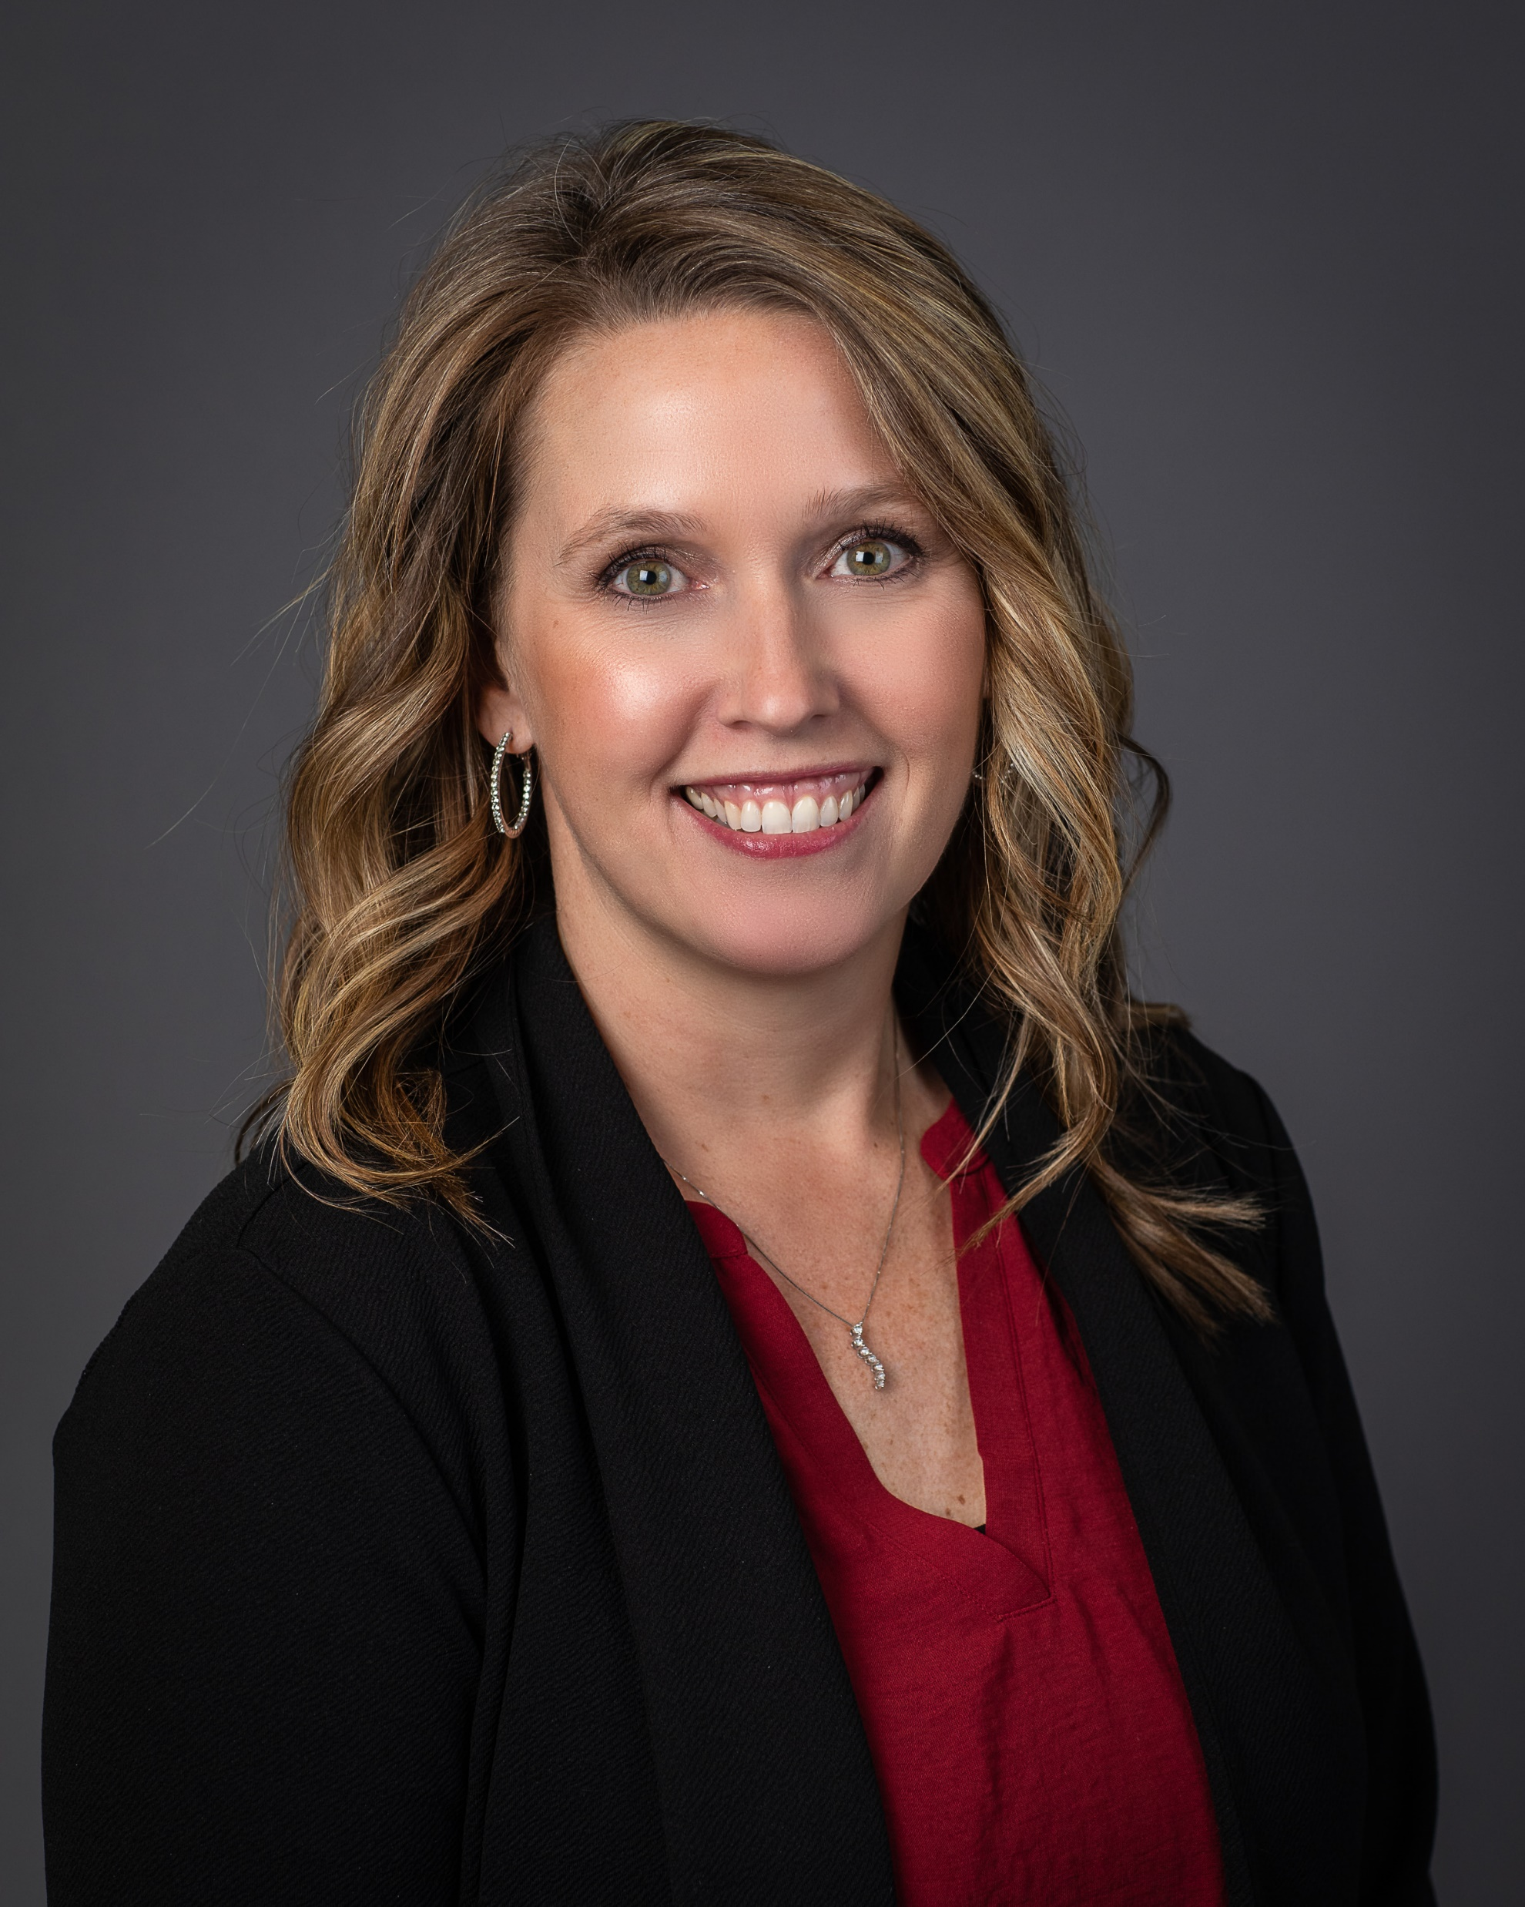
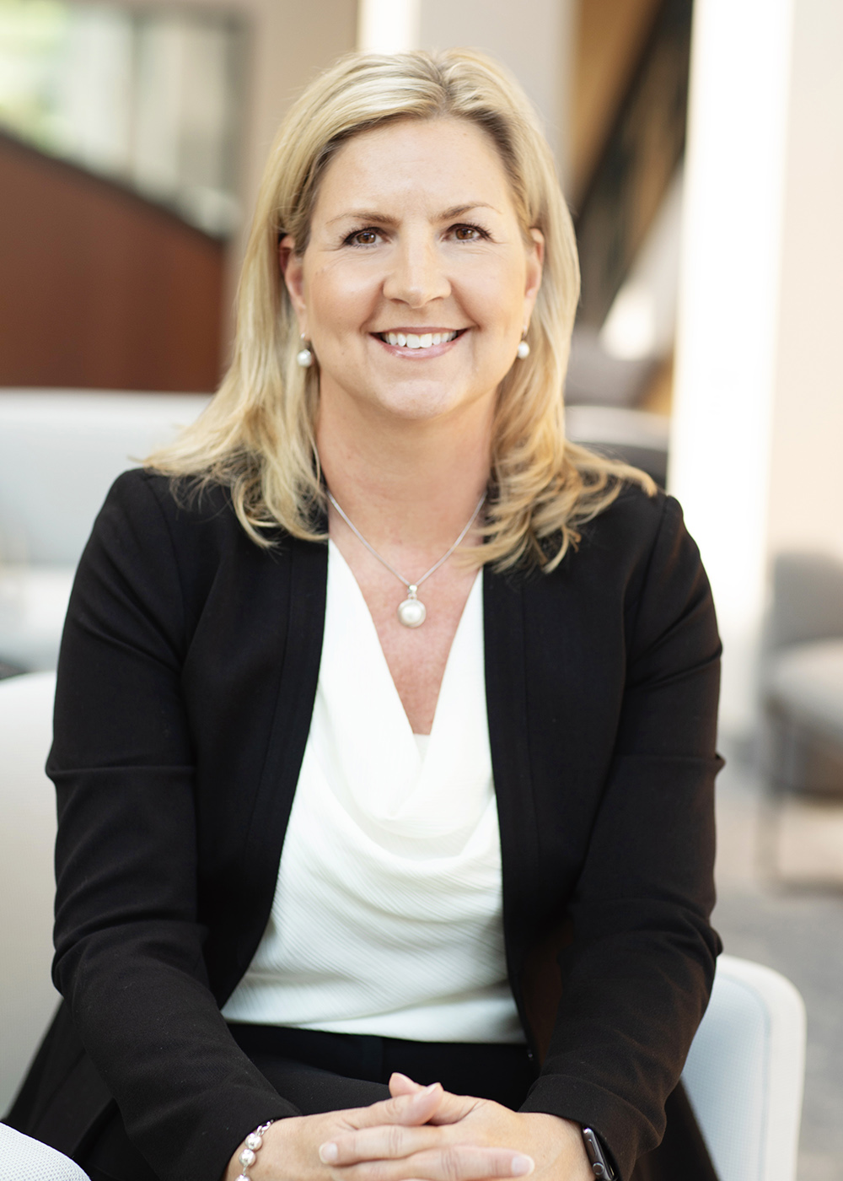
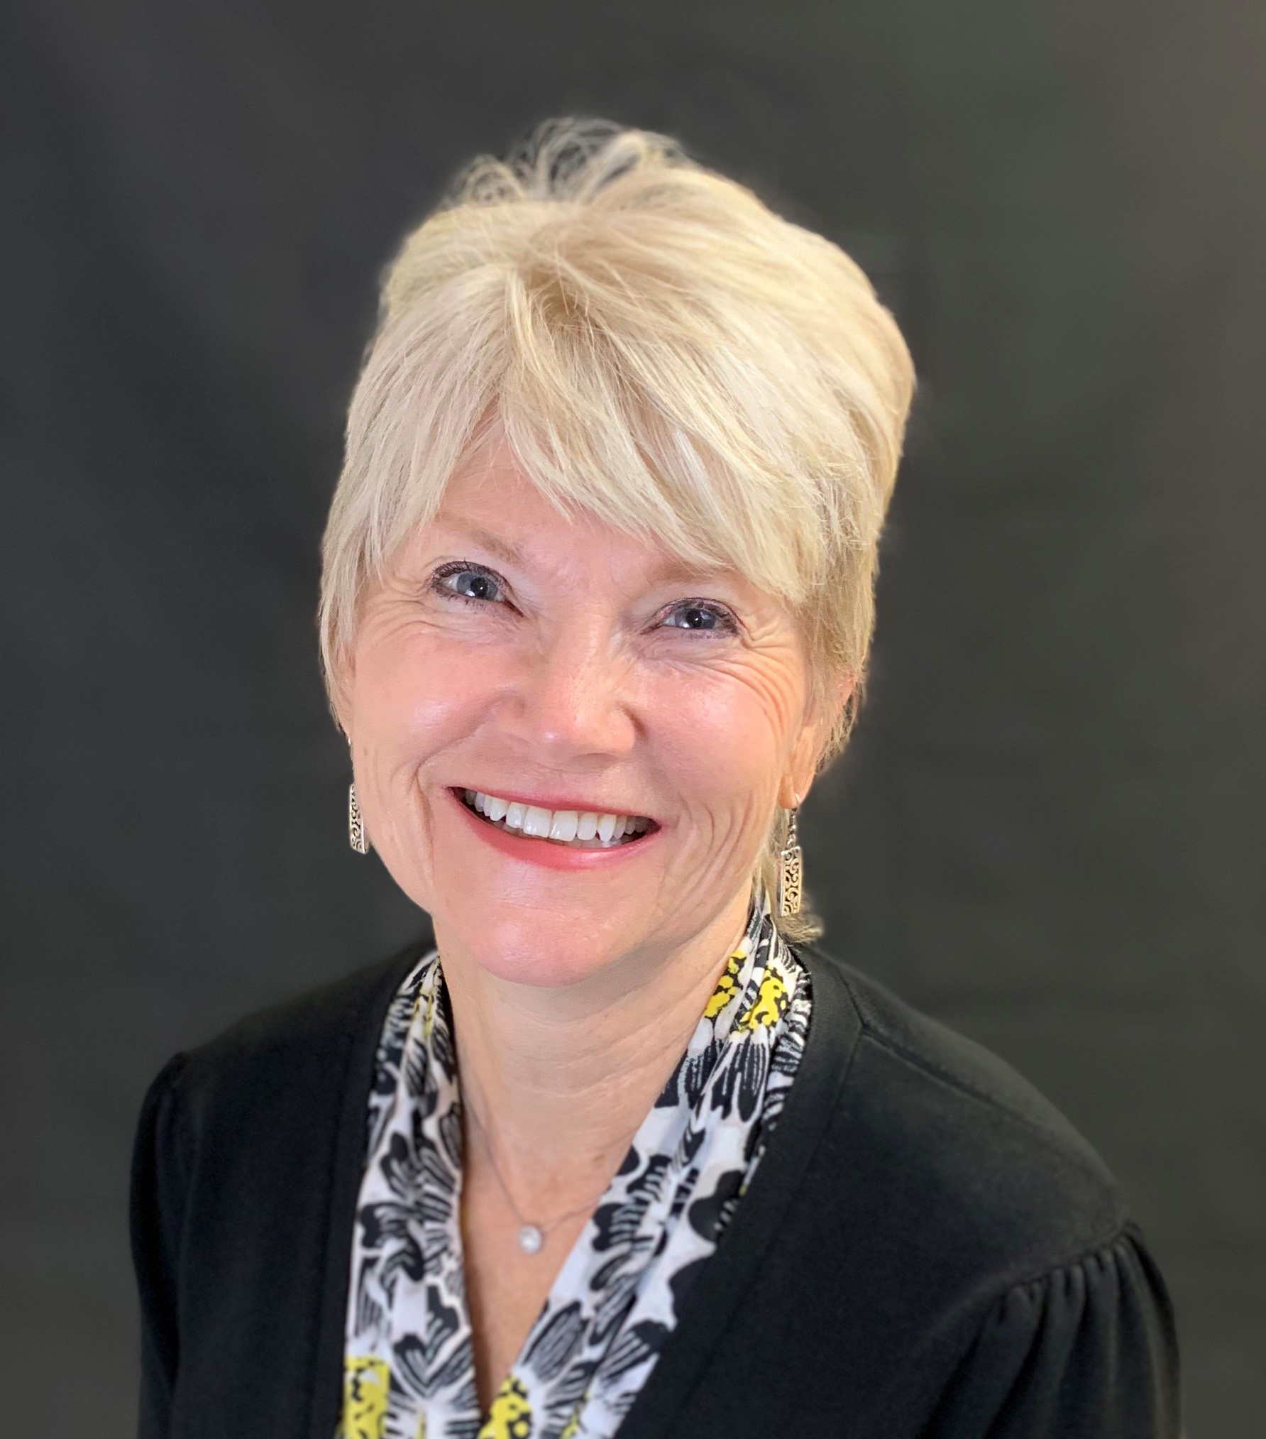
2025 Directors
Olga Baumberger
Metropolitan Community Services
Nicoleen Meyer
Accurate Home Care
Jessica Kuehlwein
Triniti
Darla Thompson
Aveanna Healthcare
Katie Troumbly
Grand Itasca Clinic & Hospital Home Care
Rochelle Wodarz
Accra Care
Janelle Shearer
Business Partner
Stratis Health

Slide 10
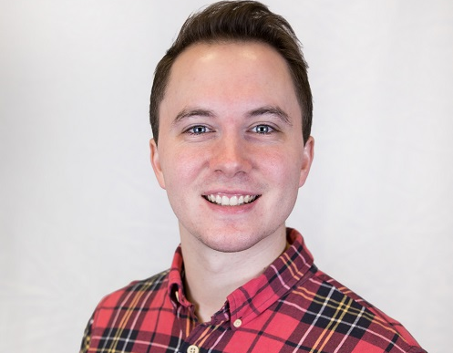
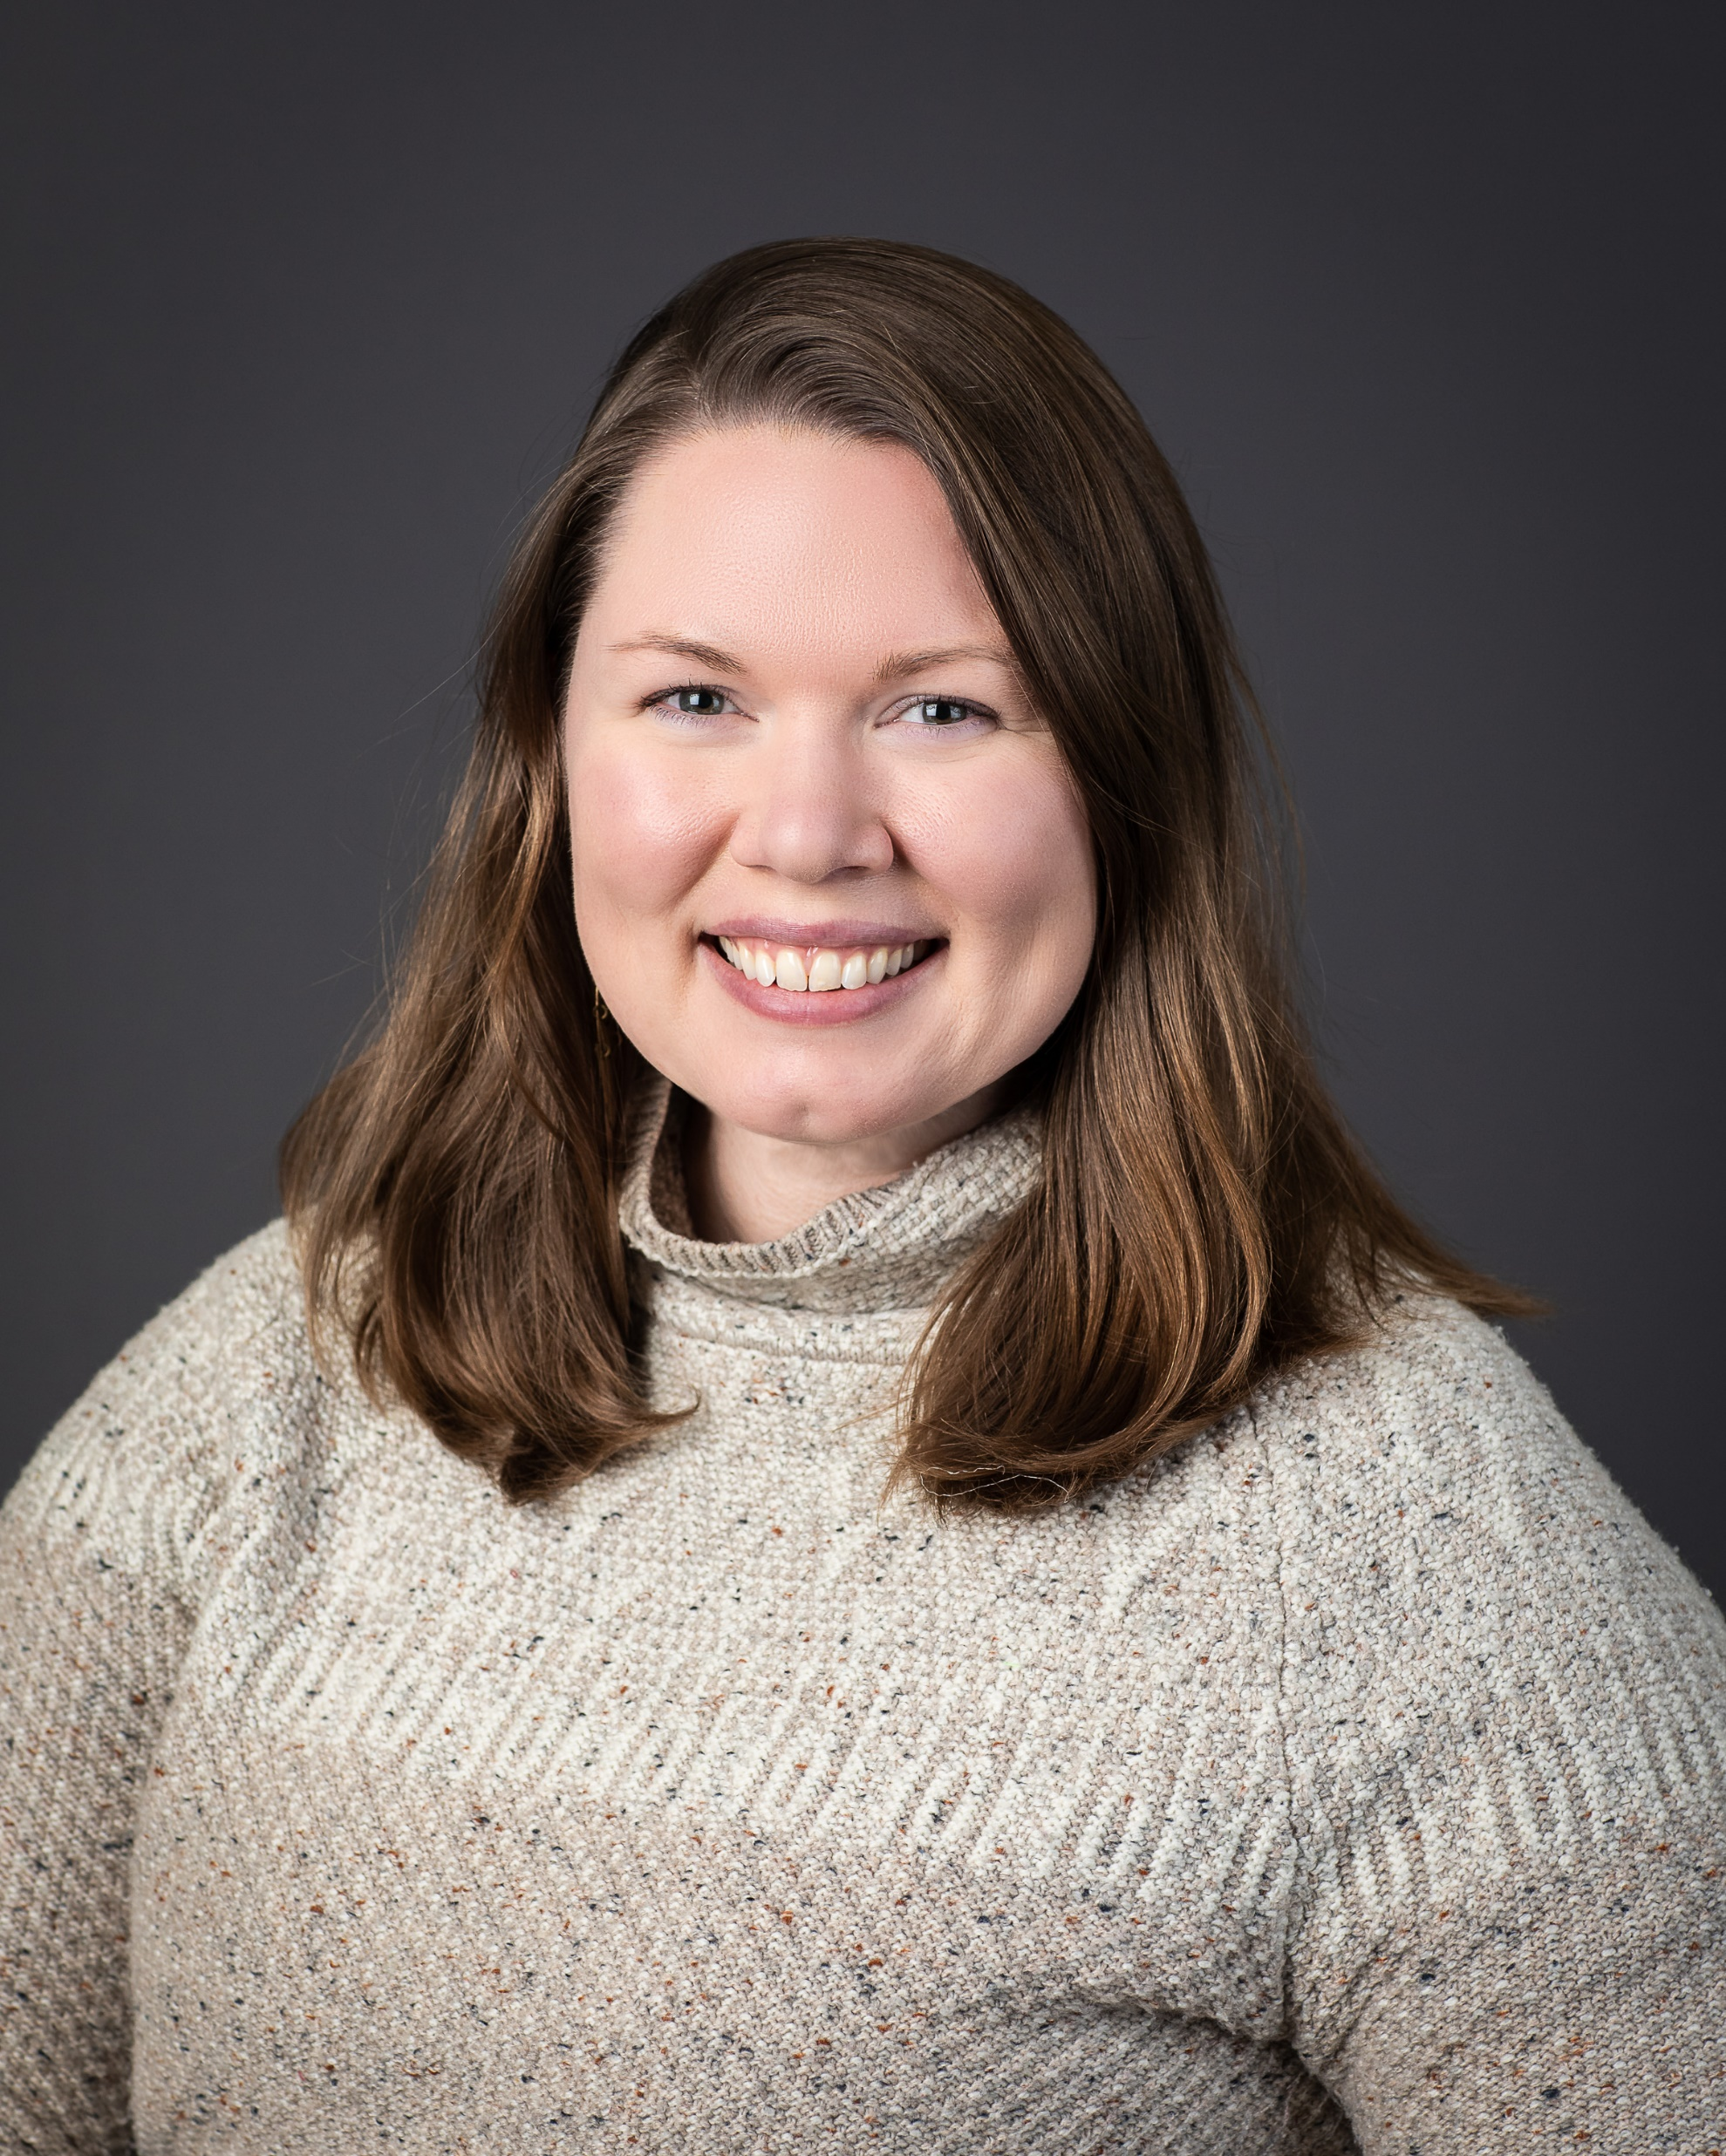
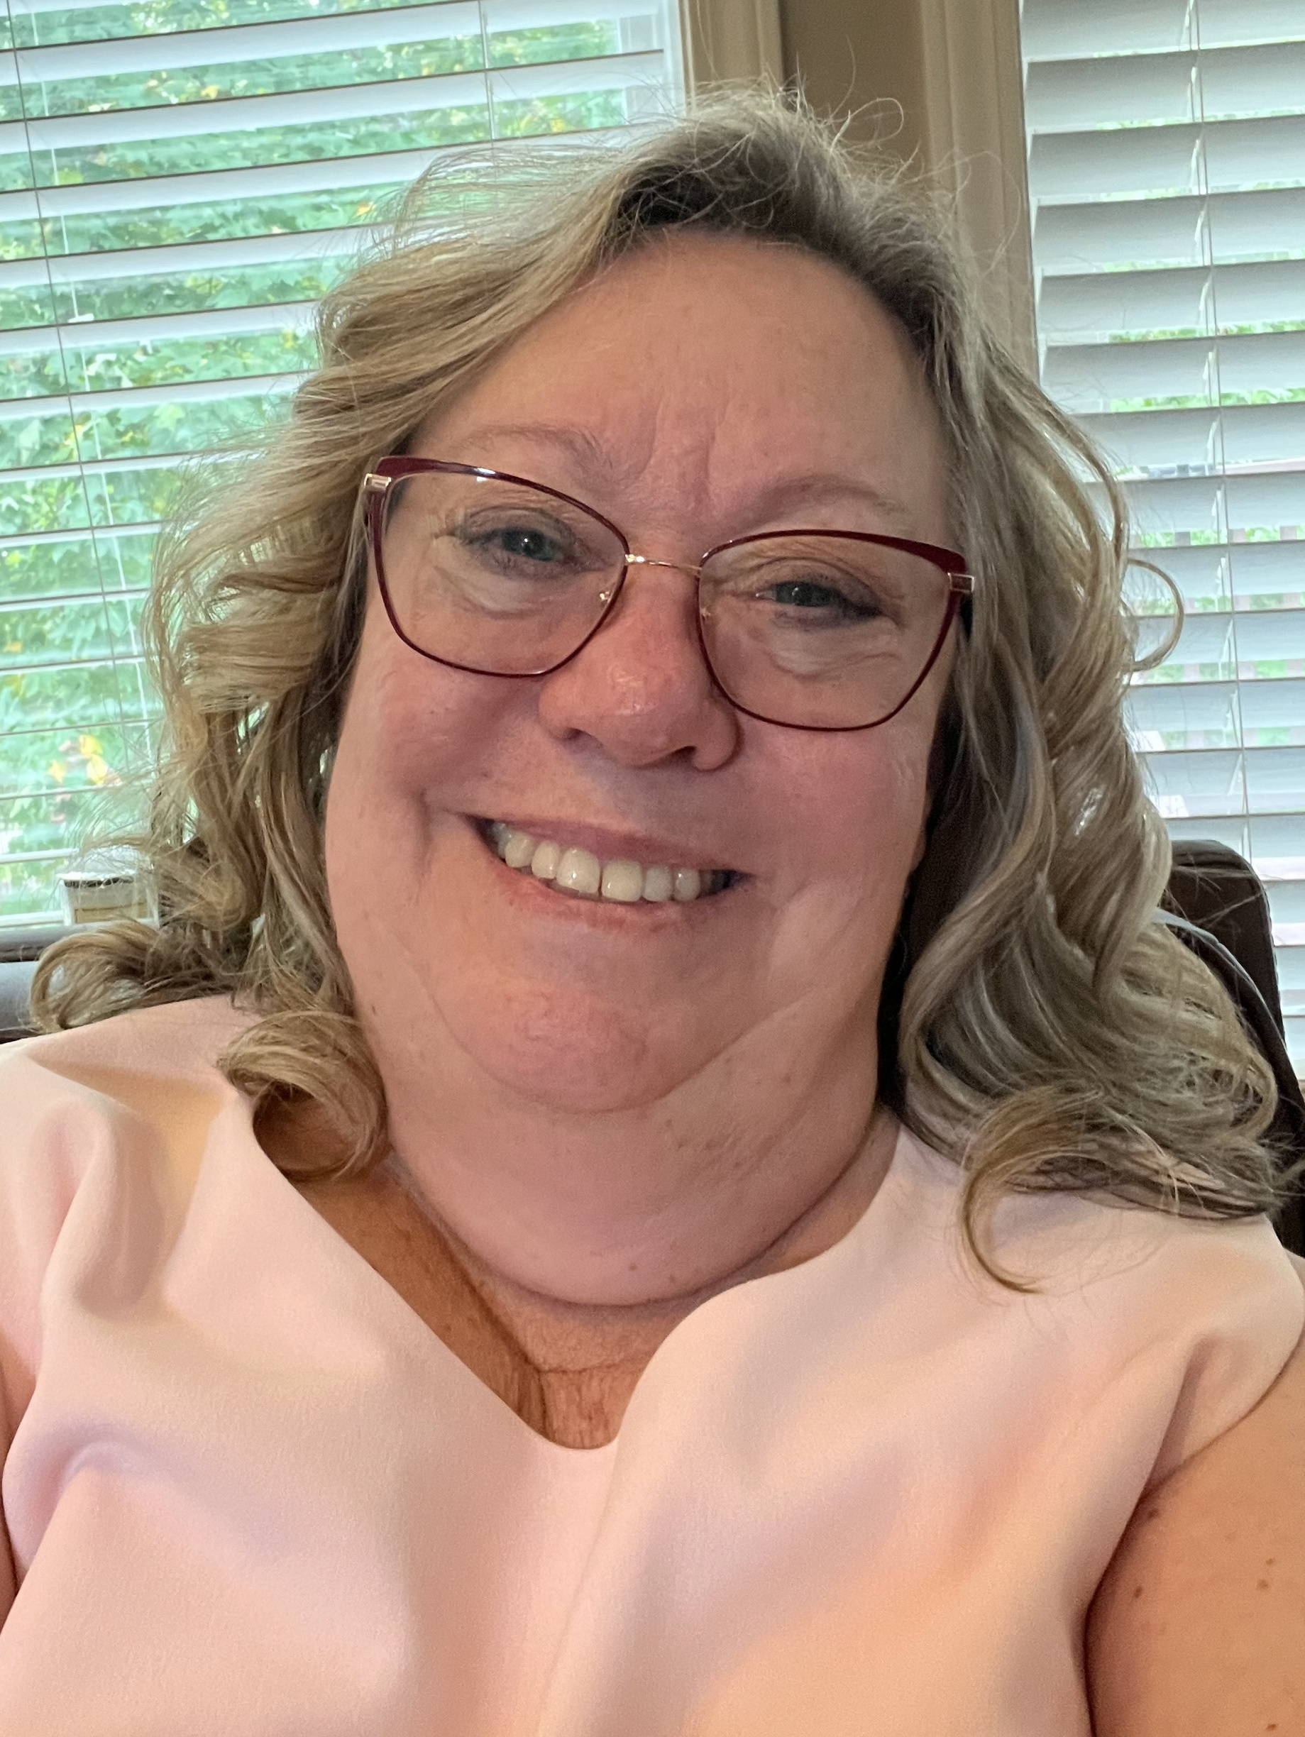
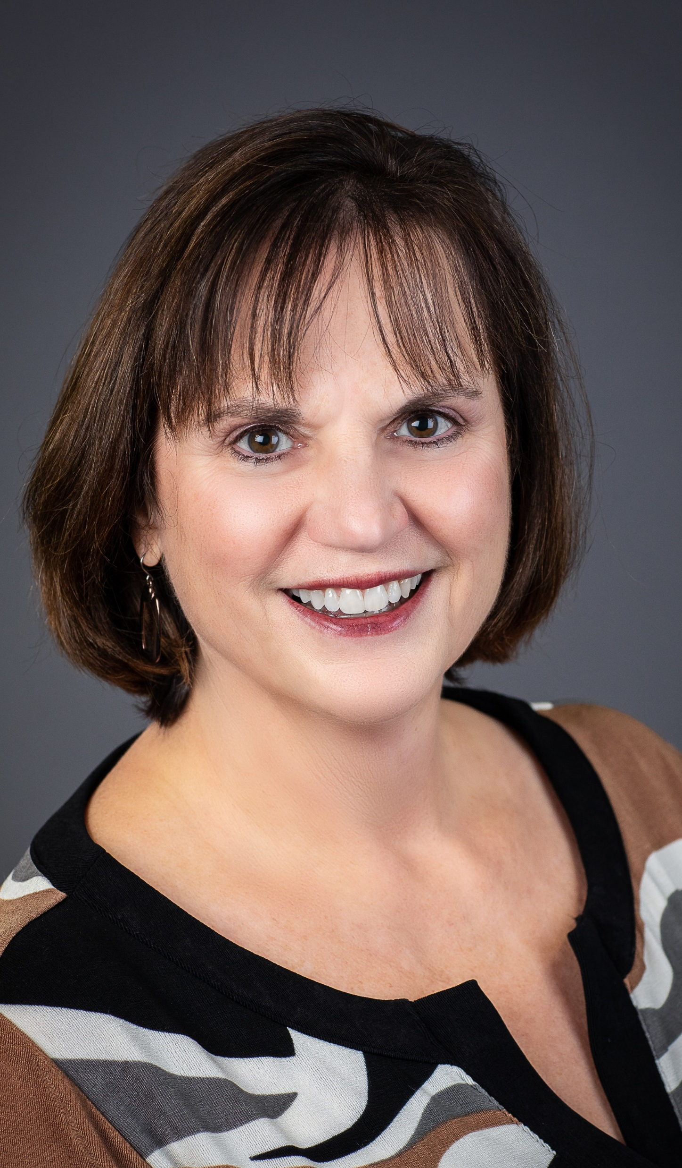

MHCA Staff

Slide 11
Board Representation
Name | Org | Region | Non-Profit | Hospital-based | Med-Cert | Comp-rehensive | HCN | PCA
Kristy Husen | CentraCare | 4 | X | X | X
Toni Diede | NextStep Homecare | 3 |  |  |  | X | X
Olga Baumberger | Metropolitan Comm. Serv. | 5 | X |  |  |  |  | X
Nicoleen Meyer | Accurate Home Care | 4 |  |  | X * |  | X - expertise | X
Darla Thompson | Aveanna Healthcare | 5 |  |  | X * | X | X - expertise
Katie Troumbly | Grand Itasca | 2 | X | X | X
Jaime Kummer | River Valley Home Care | 5 |  |  | X |  |  | X
Rochelle Wodarz | Accra | 5 | X |  | X * |  |  | X - expertise
Jessica Kuehlwein | Triniti | 4 | X |  | X

Slide 12
A Great Board…..
Reviews values & diversity regularly
Involves Purpose-Driven Leaders
Includes Directors who ask questions and don’t assume everyone understands
Engages critical thinking and insightful analysis
Stays focused on policy vs operations
Exercises common sense and doesn’t tax staff unnecessarily
Notes:
Purpose Driven - ask how what we do impacts all players in our eco-system and how we can do the most good
Insightful analysis – bring external ideas, guests in for dialogue
Policy vs Ops: ED handles all operations, including financial mgmt. & all things related to staff; board – next slide

Slide 13
Board Responsibilities
Monitor strategic & financial performance/integrity
  Approve annual budget
  Approve strategic plan
Establish association policies
Monitor Executive Director performance
Monitor board performance
Other responsibilities
  Elect Board Officers
  Approve committee structure
  Approve non-standard transactions

Slide 14
Board Responsibilities
Responsible to the MHCA membership
  Mission, Vision and Values
  Advocate for and represent home care
  Enhance membership value
Responsible for organizational governance
Represent ALL MHCA members
Attend and participate in assigned meetings

Slide 15
Board Considerations
Consider MHCA’s ecosystem
  Where should we be a leader/follower?
  What relationships should we strengthen/nurture?
How can we enhance our equity journey?
  Diversity: lived experience, expertise, age, race, gender
Are we taking enough risk?
Are we doing all we can to listen to what is most important to members?

Slide 16
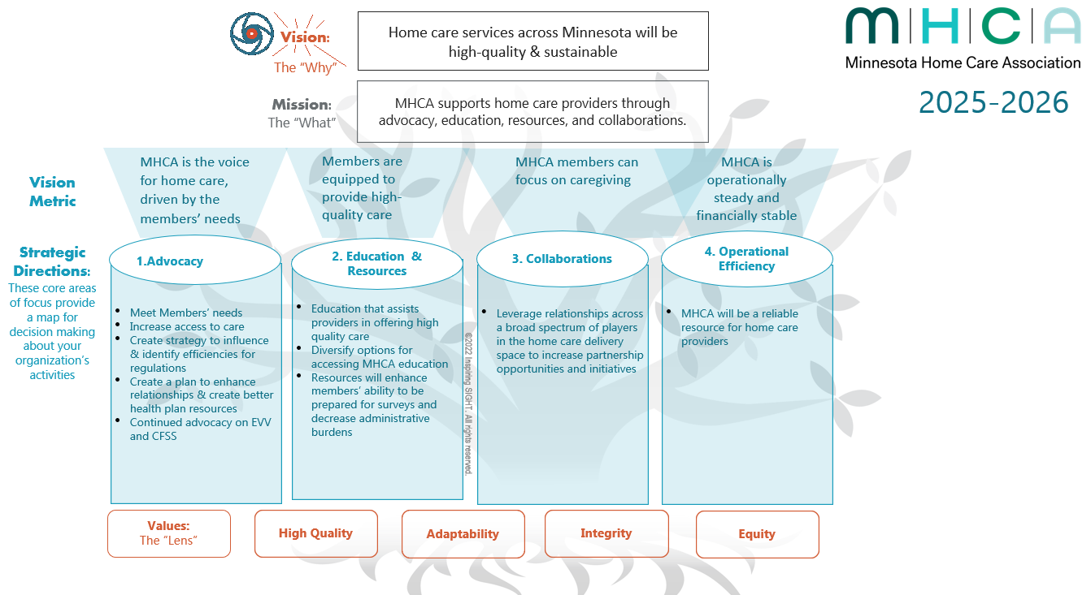
Strategic Plan

Slide 17
What is My Commitment?
Time Commitment
  Board Meeting attendance
  Committee Meetings – Board Liaison
Board Meetings Note Taker
  February 13 Katie
  May 8 Nicoleen
  August 7-8 Toni
  September 30 Olga
  December 11 Darla
Notes:
Note taker
Check bullet alignment

Slide 18
Commitment, cont’d.
Participation
  Be present & actively engaged in discussing issues, sharing perspectives, and raising questions that are essential to good decision-making.
  Actively seek, accept and carry out individual assignments in between meetings.
  Participate/attend Annual Conference, Strategic Planning
Solicit and Respond to MHCA member comments and inquiries

Slide 19
Board of Directors Composition
Maximum: 9 elected members + Past Chair + appointed Business Partner
Current: 9 voting members + 1 Business Partner
Referenced as officer or director

Slide 20
Board Officers
Nominated by the Leadership Development Committee
Elected by the Board in October or December
One-year terms, at least 2 years recommended

Slide 21
Board Chair
Presides at member, Board of Directors and Executive Committee meetings
Provides guidance, direction for program development based on strategic plan and annual objectives established by the Board.
In consultation with the Board, appoints and provides direction to persons representing MHCA on external committees.
Supervises and provides direction to the Executive Director. In consultation with the Executive Committee, conducts Executive Director’s merit/performance review and negotiates agreement/salary.
Eligibility
Have at least 1 year of service on the Board

Slide 22
Board Vice Chair
Represents the association as delegated by the Chair.
Assists the Chair in performance of his/her duties.
Conducts meetings as delegated in absence of the Chair.
In case of vacancy, serve as Chair for unexpired term.
Participates on Executive Committee.
Eligibility
Have at least 1 year of service on the Board

Slide 23
Board Secretary/Treasurer
Represents the association as may be delegated by the Chair.
Participates on Executive Committee.
Chairperson for the Finance Committee.
Is responsible for overall financial supervision of MHCA, including monthly reviews of financial statements and signing checks in accordance with MHCA policy.
In coordination with the Executive Director, reports to the Board of Directors on the financial status of MHCA and to the membership at the Annual Business Meeting.
At end of term, assist in orientation of the new Treasurer.
Eligibility
Have at least 1 year of service on the Board

Slide 24
Board Past Chair, optional
Serve as an officer to provide assistance, information, knowledge from past experience.
Perform all duties assigned or requested by the Chair.
Participates on Executive Committee, if remaining on the board.
Eligibility
Filled by person who most recently served as Chair of the Board of Directors.

Slide 25
Minute Taker
Agenda/Minutes Template
  Board members alternate taking minutes
  Date, place
  Indicate attendees
  Brief overview of each agenda item, with minimal description if it provides valuable insight (historical purposes)
  State motion exactly as worded
  Do not include who made motion
Send Minutes to Executive Director

Slide 26
Board Portal
Rosters – Board and Committees
Bylaws
Board Protocol
Board Committee Liaison
Policies
  Antitrust (Penalty $10 million)
Budget
Annual Report
Board Packets
Forms
Strategic Plan documents

Slide 27
Bylaws
Bylaws Overview

Slide 28
Committees of the Board
Executive Committee
Leadership Development Committee
Finance Committee
Standing/Ad-Hoc Committees

Slide 29
Executive Committee
Consists of the Chair, Vice Chair, the Secretary/Treasurer and the Immediate Past Chair.
Shall have the authority to act for the Board between meetings of the Board, except that the Executive Committee may not modify any action taken by the Board.
Motions made in the Executive Committee need a majority vote to pass; a tie vote fails.
Actions taken by the Executive Committee are reviewed by the Board.

Slide 30
Leadership Development Committee
Appointed by Board Chair.
One year term.
Identify and cultivate leaders.
Present a slate of candidates for board positions at Annual Meeting.
Present slate of candidates for board officers
Chair: Andrea Jung
Notes:
Advance MHCA strategic priorities
Vet candidates who have knowledge, skill set and emotional intelligence to be considered as future MHCA leaders

Slide 31
Finance Committee
Minimum of three persons, including the Secretary/Treasurer as a chairperson and at least 2 persons elected by board. Executive Committee, Jim Serakos
Present a proposed annual budget to the Board prior to the close of the fiscal year, recommend fiscal policies, review financial requests that have potentially significant impact on MHCA, assure reports are filed.

Slide 32
Standing/Ad-Hoc Committees
The Board has the ability to form standing and ad-hoc committee/task forces(s) as deemed necessary or expedient.
These “committees” will work at the direction of the Board.
The Board reserves the right to guide and/or dissolve any “committees” at any time for any reason.
Structure is aligned with Strategic Plan

Slide 33

Vision
Home care services across Minnesota will be high-quality & sustainable.
Mission
MHCA serves home care providers through advocacy, education, resources, and collaborations.
MHCA'S COMMITTEES & WORKGROUPS
ADVOCACY COMMITTEE
CLINICAL, REHAB AND REGULATORY COMMITTEE
MEMBER RELATIONS & EDUCATION COMMITTEE
Chair: Angie Andresen
Board Liaison: Olga Baumberger
& Darla Thompson
Staff Liaison: Kathy Messerli
Chair: Kristin DeBoer
Vice Chair: Kristin Sundgaard
Board Liaison: Jessica Kuehlwein
Staff Liaison: Paulette Duncan
Chair: Stephanie Thiede
Vice Chair: Heather Scherping
Board Liaison: Toni Diede
Staff Liaison: Melissa Stenberg & Dan Atwood
Staff Liaison:
Paulette Duncan
Staff Liaison:
Kathy Messerli
DHS Liaison Workgroup
MDH Liaison Workgroup
Medicare/CMS & NGS Liaison
Payer Liaison Workgroup
Workforce Workgroup
Chair:
Vicki Gerrits
Vice Chair:
Amanda Whitmore
Board Liaison:
Rochelle Wodarz
Staff Liaison:
Paulette Duncan
Chair:
Barb Jezorski
Vice Chair:
Rachel Eastwood
Board Liaison:
Katie Troumbly
Staff Liaison:
Paulette Duncan
Chair:
Katie Wagner
Vice Chair:
Marnie Pogreba
Board Liaison:
Jaime Kummer
Staff Liaison:
Paulette Duncan
Chair:
Angela Swanson
Vice Chair:
KC Ferk
Board Liaison:
Nicoleen Meyer
Staff Liaison:
Kathy Messerli

Slide 34
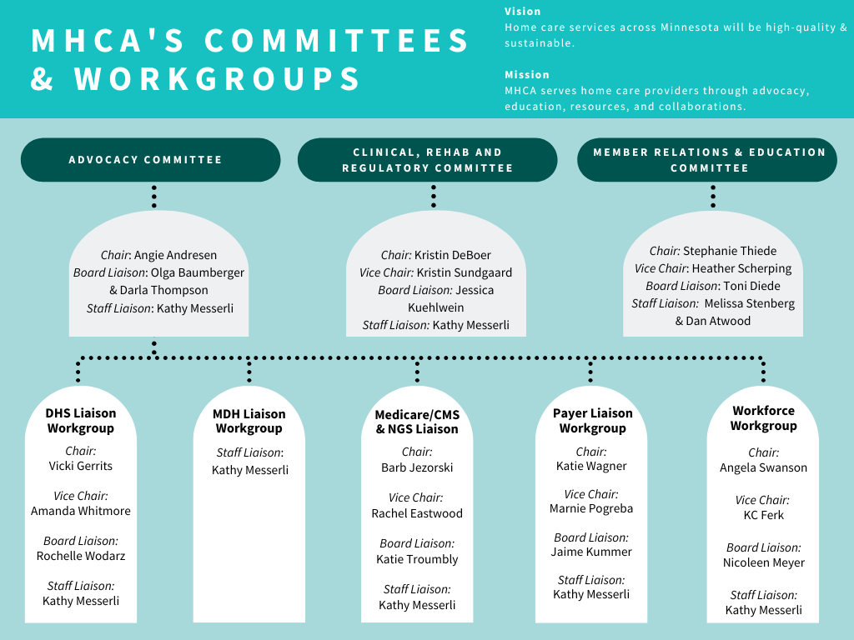
Notes:
Jessica - CRR

Slide 35
Special Groups
IDEA: Inclusion, Diversity, Equity, Awareness
AI - 2025
Others, as needed

Slide 36
Board Liaison
Facilitate communication between board & committee
Provide direction & guidance – focus on strategic priorities
Communicate regularly with committee leader
Attend committee meetings at least occasionally
Be familiar with activity and report highlights to board. Staff will determine which committees have updates for the agenda.

Slide 37
Board Liaison Role
Do…
Clarify for the committee board charge, expectation.
Serve as a resource.
Encourage progress and leadership.
Be prepared to update and clarify.
Don’t…
Dominate the meeting.
Lead the discussion.
Bring personal agenda.
Bob Harris, CAE

Slide 38
Policies & Procedures
Committee Protocol
Anti-Trust
  Anticompetitive business conduct
  Meeting, listservs, conference
  Penalty = $10 million

Slide 39
Member Listservs/Meetups
Member Listservs for sharing ideas:
  Billers
  Coders
  Compliance – Medicare
  Compliance - Comprehensive
  DHS-related
  Rehab
Member Meetup Groups:
  Survey Watch
  Rehab
Notes:
Missing any??

Slide 40
Professional Services/Contracts
Accountant/Taxes: Serakos, Ltd
Accounting Services: All in One Accounting
Legal/Lobbying: Fredrikson & Byron
Regulatory Consultants: Connie Dreyer
Online Education Member Benefit: RCTC

Slide 41
Questions/Discussion?

Slide 42
MHCA Thanks You!

