Slide 1
Minnesota Home Care Association: Updates from DHS and Looking Forward
Natasha Merz|
Assistant Commissioner, Aging and Adult Services Administration
Optional Tagline Goes Here | mn.gov/websiteurl

Slide 2
Agenda for Today
Composition of and Vision for The Aging and Disability Services Division
2023 legislative session – implementation updates, future priorities
EVV and PCA Cost Reporting
Q and A

Slide 3
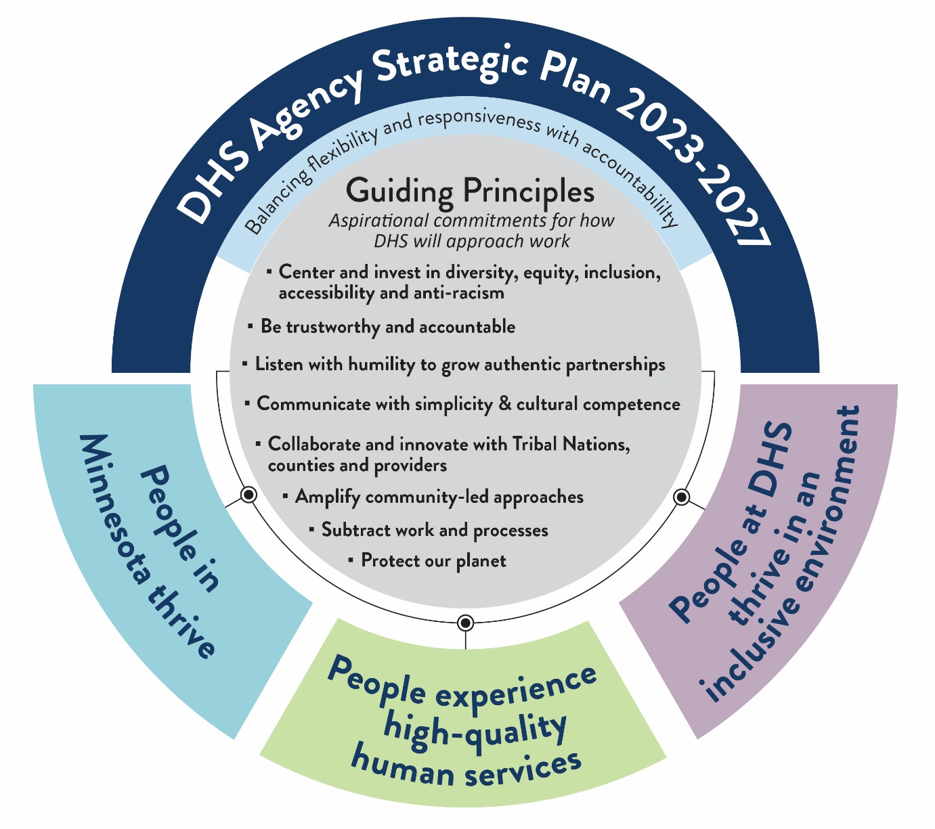
DHS Strategic Plan 2023-2027
Mission
Vision
Values​
Structure:
Guiding Principles
How DHS will approach work
Outcomes
People-centered outcomes
Goals
Attainable end results
Key Metrics and Milestones
Measurable indicators of goal progress
Select strategies
Types of action in service of plan goals

Slide 4
People in MN Thrive
-Greater MN: tailor services to unique needs in every corner of the state
-Ensure and advocate for living wages, career ladders, and other incentives to maintain workforce
-Expand continuum of services including self directed options
- ensure availability and high quality of services
People Experience a High Quality Human Services System
Uniformly apply the equity analysis tool to legislative proposals and long-term planning
Continue to support strategies and methods to eliminate bias and discrimination in the human services system
People at DHS thrive in an Anti-racist, Multicultural, Equitable Organization
Prioritize and grow leadership competencies in psychological safety to serve and empower employees
Foster an environment of flexibility, responsiveness and trustworthiness where be can be their authentic selves
Notes:
These are examples of strategies that are a part of the DHS strategic plan, not an overview of the plan itself – would be happy to come back and do a deeper dive at a different time
The third goal area is internally focused, so won’t spend time there. Some have asked why this is important or necessary in a plan; we have burnout in our staff and structural inequities as other large organizations, so this recodnizes that when our staff are supported, they are more available to the other important work in this paln
Equity and anti-racism are present in all of these goals, values, and subgoals

Slide 5
Vision for Aging and Disability Services Administration
Alignment with One Minnesota and DHS Strategic Plan
Tailored for people, providers, and lead agencies in the context of Long-Term Services and Support
Alignment across programs, where it make sense – including PCA and Home Health Services
Also, waivers (CADI, CAC, BI, DD, EW), and Alternative Care
Integration of services provided under the Older Americans Act with Medicaid Services
Simplification and subtraction of processes and steps that don’t add value
Focus on advancing equity, working to eliminate disparities, and anti-racism in internal culture and in programs
Government to Government relationships with Tribal Nations
Still a work in progress

Slide 6
Our North Star Value: Positive Supports
Positive Supports refers to all practices that include the following characteristics:
Person- centered interventions that demonstrate cultural competence and respect for human dignity
Evidence- based and promising practices
Include strategies for ongoing assessment and monitoring at individual and organizational levels
Are often implemented in combination with more than one practice

Slide 7
Examples of Positive Support Strategies
Person- centered thinking/ planning- foundational values
Positive behavior support
Applied behavior analysis
Assertive community treatment
Cognitive behavior therapy
Dialectical behavior therapy
Motivational interviewing
Wraparound planning/ Systems of care
Trauma informed practices
School- linked mental health

Slide 8
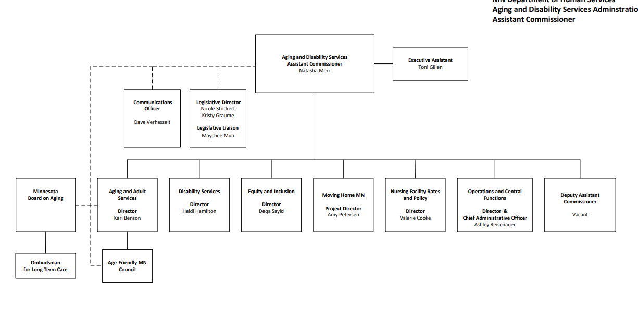
Acute and complex transitions

Slide 9
Home Care Provisions(SF 2934, HF 1403)
Personal Care Assistance/Community First Services and Supports
CFSS rate increases
CFSS tiered rate based on staff experience
PCA transportation time billable
QP Remote Supervision
Notes:
Highlights:
- Investment of over 880m in CFSS over the next two biennia
- PCA Transportation is effective 90 days after federal approval and makes transporting a person as a PCA billable time. We are working to get the notice in the state register by June 16th to make this happen ASAP
Allows parents and spouses of people in CFSS/CDCS to deliver up to 80 hours of services to a person if there are two parents, 60 hours if one/spouse
QP remote supervision: allows for remote delivery of QP supervision for people with chronic health conditions

Slide 10
Rate Increases Continued(SF 2934, HF 1403)
Respite as market rate (expected to lead to increased rates)
Increase CWF (up to 6.7%)
CADI/BI CL rate increase (12%)
Homemaker (rate alignment between DWRS & EW + inflation)
Home health, skilled nurse visits, Therapies (14.99%)
HCN rate increase (25%)
Home delivered meals, chore, community living assistance, family care giver rate increases
Notes:
Workforce incentive grants will be available to 245D, ICF/DD, Nursing Facility, PCA, CFSS, EIDBI, FMS, Customized living providers. Note: Additional funds were provided in the final Nursing Home bill and 20 million was added to this fund in the Paid Family Leave bill to cover the cost of the payroll tax. More information will be coming on how this will be administered.
ICF/DDs received a new daily rate floor ($275 for class A, 3416 for Class B) and a $40 increase. Automatic, annual, inflationary adjustments were also added to their rate (Effective Jan 1, 2024 or upon federal approval)
Over $300 million was invested in DWRS inflationary adjustments over the next four biennia
The Competitive Workforce Factor for DWRS services was also increased to 6.7% (effective Jan 1, 2024 or upon federal approval)
Shared Services: IHS could be shared be three people, night supervision by two people. DHS is directed to seek additional shared staff capacity for chore and homemaker

Slide 11
Grant Programs
New Grant Programs
Workforce incentive grants (90 million, Includes Aging programs)
Long Term Care Workforce Grants for New Americans (60 million)
New funding for existing program
Provider Capacity Grants for Rural and Underserved Communities (18.8 million)
Notes:
Workforce incentive grants will be available to 245D, ICF/DD, Nursing Facility, PCA, CFSS, EIDBI, FMS, Customized living providers. Note: Additional funds were provided in the final Nursing Home bill and 20 million was added to this fund in the Paid Family Leave bill to cover the cost of the payroll tax. More information will be coming on how this will be administered.
New grant programs are one-time money with 4 year carry forward (will need additional legislative authority and funding to continue them)

Slide 12
Research/Studies
Labor market reporting - getting direct feedback from direct support professionals
Acute care transitions commission
Waiver services expansion/1915i study
Crisis, respite, positive support
Presumptive eligibility study- MA financial and functional eligibility

Slide 13
Electronic Visit Verification

Slide 14
MN Key Legislative Principles
Minimally Burdensome
Administrative
Financially
Least Disruptive
Receiving services
Allowed services
Consideration
Existing best practices
Follow
State laws
Federal Laws
DHS Policies
Notes:
Minnesota Statute 256B.073 reflects and expands on 21st Century Cures Act requirements to ensure that the EVV system:
is minimally administratively and financially burdensome to a provider;
is minimally burdensome to the service recipient and the least disruptive to the service recipient in receiving and maintaining allowed services;
considers existing best practices and use of electronic visit verification;
is conducted according to all state and federal laws and DHS policies;

Slide 15
MN Partners Feedback
EVV System
Mobile
Adaptability
Ease of Use
Minimize Privacy Intrusion
Flexible Scheduling
Notes:
Public meetings were held both in the metro, in Greater Minnesota, and via webinar to collect stakeholder input on EVV focusing on what would make EVV minimally burdensome.
These meetings included People who use services, providers of services and workers.
These were their recommendations, EVV should:
be as mobile as the people using it and support individuals wherever the person uses services.
avoid rigid scheduling rules, allowing for ease of schedule changes based on the person’s needs
have flexibility and adaptability related to internet access or mobile devices, able to accommodate limited or no internet access where personal care service are delivered
prioritize ease of use, regardless of language or ability
minimize privacy intrusion, including those created by collecting the location of service delivery

Slide 16
Timeline
June 20, 2022
Financial Management Services (FMS) for personal care
December 12, 2022
Fee for Service (FFS) Personal Care Services
June 5, 2023
Managed Care Organizations (MCOs) personal care services
October 16, 2023
Home health services for both FFS and MCOs
Notes:
DHS chose to implement EVV in a phased approach by service type. The expectations for providers is that they begin implementing in their corresponding phase.
This allowed time to onboard each phase with HHAX and to integrate third party systems in a timely manner.
It also allowed DHS to observe how implementation was going to be able to prepare and adjust for the next implementation phase.
DHS will be completing it’s finally phase of implementation on October 16, 2023, with home health providers

Slide 17
Current Compliance Requirements for Providers
Soft Launch
Onboard
Routine
Compliance
Notes:
DHS is implementing EVV in a soft launch to allow providers time to onboard into their chosen EVV system, including time to onboard caregivers and members.
It will take time for EVV to become routine for providers, caregivers and members.
Providers will receive notice before full system usage is required.

Slide 18
Engagement
DHS is committed to engagement from all partners impacted by EVV.
Partner engagement through each phase
EVV quarterly update sessions hosted by DHS
Elist announcements
Webpage updates
EVV mailbox
Notes:
DHS has gained valuable insights and received continued feedback that has helped to refine our approach to EVV.

Slide 19
Resources
21st Century Cures Act, EVV: Section 12006(a) of the 21st Century Cures Act (PDF)
Minnesota EVV Statute: Minnesota Statute 256B.073
Safe at Home: Minnesota Statutes, Chapter 5B and Minnesota Rules Chapter 8290
HHAX Minnesota Provider Information Center webpage
HHAX Minnesota EVV – FAQs (PDF)
DHS Electronic visit verification webpage
DHS Electronic visit verification (EVV) Community-Based Services Manual

Slide 20
Cost Reporting: CFSS and PCA

Slide 21
Why is Cost Reporting Important?
The reporting of the actual costs of providing services through the established cost components of the rate framework for agencies
The purpose of this reporting is to collect cost data that will further inform the rate framework.
The ongoing collection of this data will inform policy makers of the cost of rates and allow reimbursement rates to reflect costs, encourage provider viability, and help ensure service access.

Slide 22
What Will Be Reported
PCA wages (all pay types), benefits, and payroll taxes
Administrative and supervision wages, benefits, and payroll taxes
Administrative facilities costs, including all building and maintenance costs
Administrative costs specific to providing PCA services
These could include background studies, documentation time, training, and absences
General administrative costs of running a business

Slide 23
Timelines and Provider Support
This is a new initiative that was passed in 2021 by the legislature. Development for this effort is over 80% done and we are on schedule to send out first notifications for providers on March 31, 2024. Providers should:
Keep an eye on e-lists for notifications about trainings and additional information like website and manual launches.
Update their contact information with current email addresses in the provider portal (MPSE)

Slide 24
Hospital Decompression vs Acute Care Transitions
Hospital Decompression
COVID-related initiative
Objective: make room in hospitals so people have access to acute care
Acute Care Transition Work
Objective: support person, including kids, in accessing the right services at the right time to facilitate timely and safe discharge from an acute care setting
Support returning to home or community-based setting whenever possible
Access to the appropriate level of care
Preventing readmission through more robust transition planning and coordination
Notes:
As we sift through our information, first recognize evolution of hospital decompression. Started as a COVID-related initiative to literally make room in hospitals to treat COVID patients. Evolved to now supporting individuals who are “stuck” in a hospital setting.
Acute care transition has two components: working with individual situations and identification of systemic gaps and barriers that are the root cause of the problem. Both are important and defining roles between DHS, lead agencies, providers, and hospital systems is essential for success or progress on both components, but they are distinct from each other (we can’t solve systemic problems at individual patient care conferences)

Slide 25
Acute and Complex Transitions: We Need Your Help
What would it take or what is missing that would enable your organization to admit people, including children, with complex needs?
Or, what else do you need?
Notes:
Acknowledge partnership and leadership form ARRM providers in this space already; commitment to positive supports and person-centered practices. Please join me at lunch table for further conversation
Different financial incentives?
Better training and support for DSPs
More robust coordination with counties
Regulatory flexibilities?
Better support during a crisis?
Access to medical care?

Slide 26
Questions?

Slide 27
Thank You!
Natasha Merz
Natasha.m.merz@state.mn.us

