Slide 1


HSRM Training for community partners
Sara MaKarrall, RN
Home and Community Based Care
St. Cloud VA Health Care System
Phone: 320-255-6369 Option 3
sara.makarrall@va.gov

Slide 2
Objectives:
Additional Referral Information
Offline Referral Form
Upload Document
Task List
Download Document
Please note that screen shots may show more options than what are available to Community Providers.

Slide 3
Additional Referral Information

Slide 4
What is Additional Referral Information?
Additional Referral Information shows all entries made by HCBC staff into the Veteran’s EMR at the VA.
Why is Additional Referral Information important?
The details of these entries include the authorized services and frequencies.
Also documented in these comments are the start and end authorization dates, as well as referral/authorization number.

Slide 5
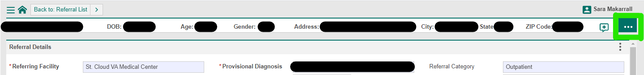
Where do I find Additional Referral Information?
Select Veteran in patient list
Select correct referral you are wanting to access
While on the “Referral Details” page, you will click on the 3 HORIZONTAL dots in the upper right corner of the screen (right under your name)

Slide 6
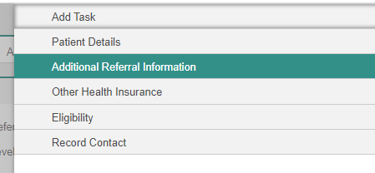
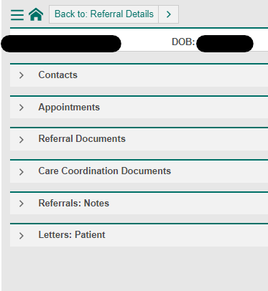
Click on Additional Referral Information
The following headings are listed under the Additional Referral Information tab. (These headings are open upon clicking into Additional Referral Information)

Slide 7
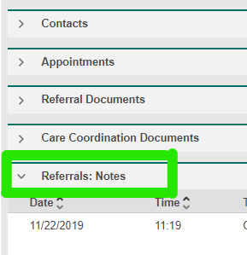
Scroll to the “Referrals: Notes” section (about halfway down the page). This is where you will find all entries made by HCBC in the EMR at the VA

Slide 8
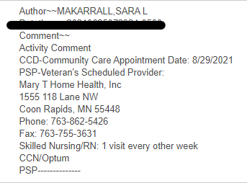
After entering consult (order) and adding SEOC to consult, you will see the following information:
Start Date of Authorization
Agency Information
Services Authorized
Payor Source

Slide 9
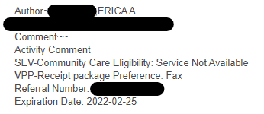
After previous comment, you will find the following entry from the HCBC Schedulers (Mary and Erica):
How referral was sent to agency
Referral Number
Authorization end date

Slide 10
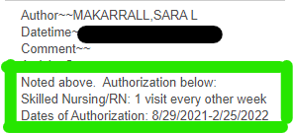
To summarize all of the previous entries, you may find the following entry:

Slide 11
Offline Referral Form

Slide 12
What is the “Offline Referral Form”?
This is the form that HCBC has historically been faxed to agencies with the authorization information

Slide 13
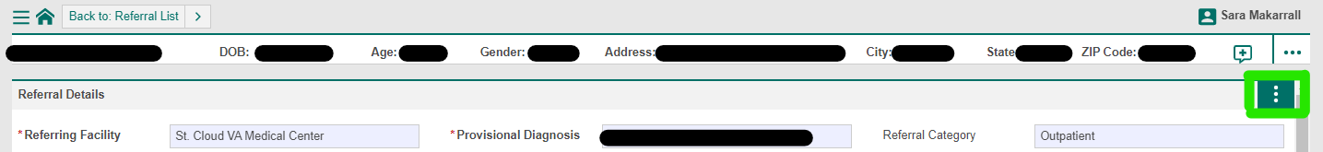
Where do I find the Offline Referral Form?
From the Referral Details page, click on the three VERTICLE dots on the right-hand side of the screen (next to the scroll bar)

Slide 14
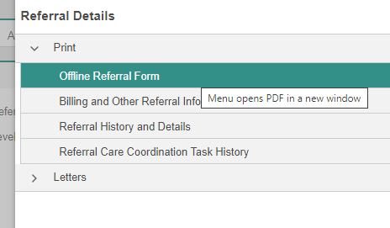
Where do I find the Offline Referral Form?
Then click on the “Offline Referral Form”, and a new window will open displaying the form that was historically faxed to agencies with authorization information.

Slide 15
Upload Document

Slide 16
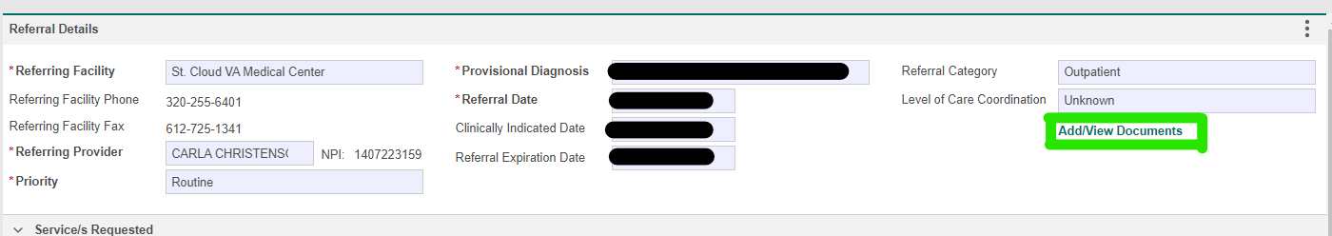
How to UPLOAD a document to HSRM Portal:
While in the Referral Details page, you will want to click on the Green “Add/View Documents” text
You will be brought to the Documents page after clicking on the Add/View Documents.

Slide 17
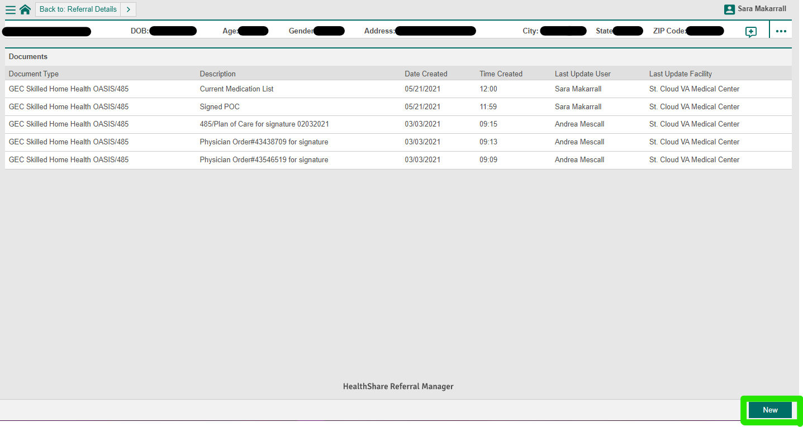
How to UPLOAD a document to HSRM Portal:
You will see all of the documents that have previously been uploaded.
To add a NEW document, you will click the New button in the bottom right-hand corner

Slide 18
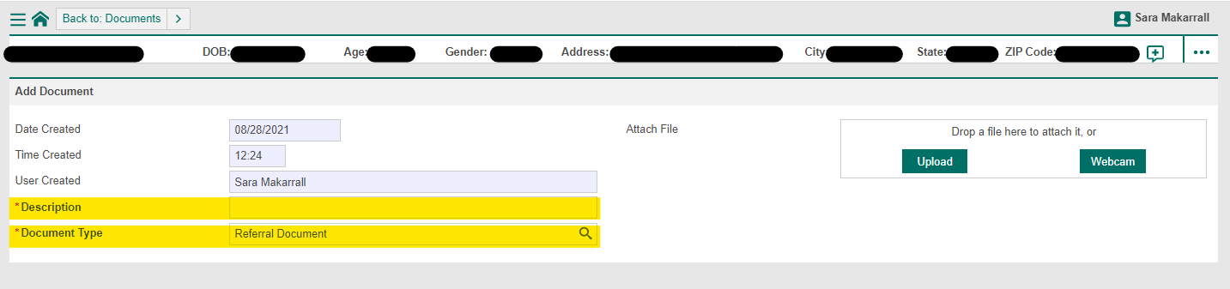
How to UPLOAD a document to HSRM Portal:
You will be brought to the Add Document screen- as seen below.
A Description is required. Please be as descriptive as possible:
Plan of Care 9/1/2021-11/1/2021
Physician Order # 0123456
Extension of Services Packet 9/1/2021 (Last date of authorization)

Slide 19
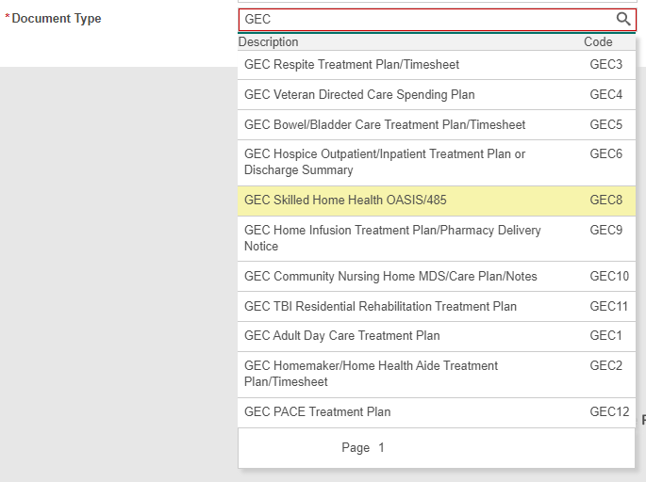
How to UPLOAD a document to HSRM Portal:
The Document Type should be changed from “Referral Document” (auto generates) to appropriate “GEC” document (You will type in GEC to populate list)
“GEC Skilled Home Health OASIS/485” for skilled referrals
“GEC Homemaker/Home Health Aide Treatment Plan/Timesheet” for non-skilled referrals
  Although the document may not be what the Document Type states, please utilize these Document Type titles- as this is the Task that HCBC checks for new documents

Slide 20
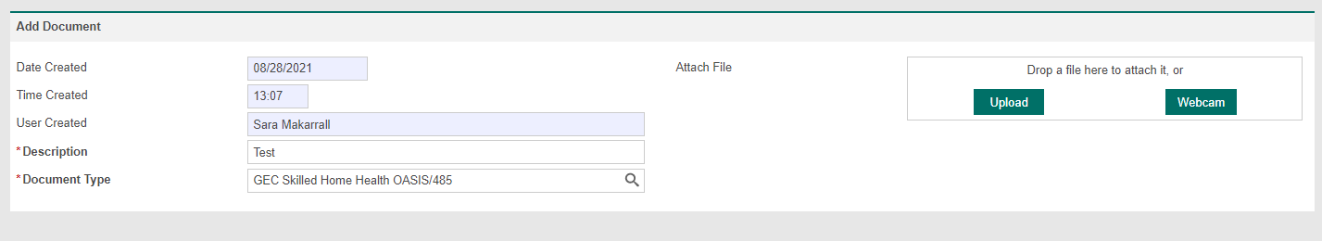
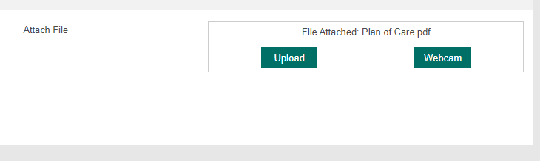
How to UPLOAD a document to HSRM Portal:
You will then click the “Upload” button, and select the file that you wish to Upload
Notice the “Drop a file here to attach it, or changes to File attached: (file name)

Slide 21
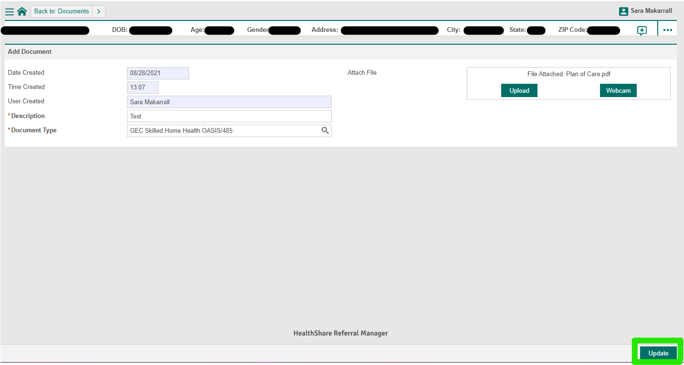
How to UPLOAD a document to HSRM Portal:
After you have entered a Description, Document Type, and Uploaded a document, you will click the “Update” button in the bottom right corner.

Slide 22
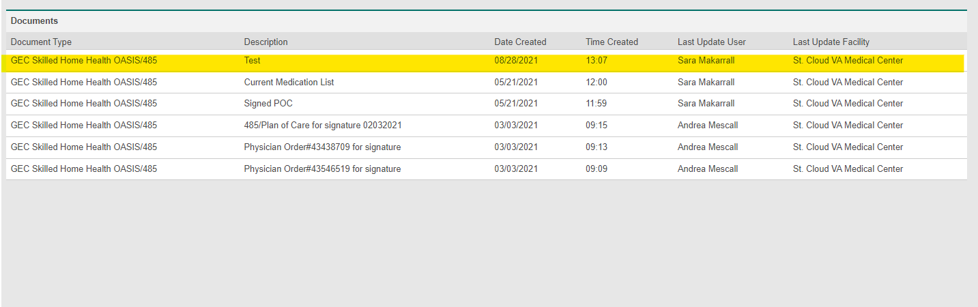
How to UPLOAD a document to HSRM Portal:
You will then be brought back to the “Documents” page, and the document that was just uploaded will be on the top of the list.

Slide 23
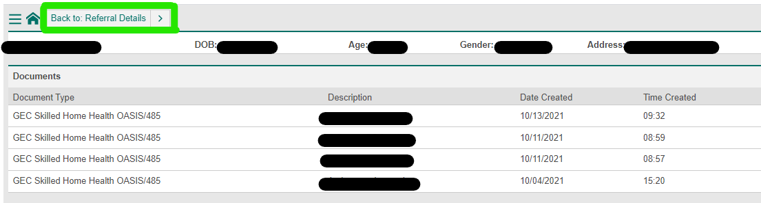
How to UPLOAD a document to HSRM Portal
Creating a Task:
You will then need to create a task to alert the VA to the document uploaded.
    From the ‘Documents’ page, click the “Back to: Referral Details” button in the top left corner of the screen

Slide 24
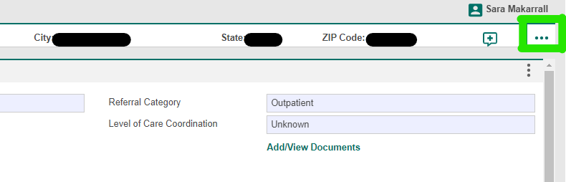
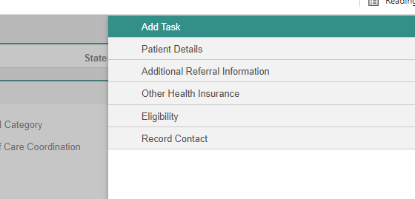
How to UPLOAD a document to HSRM Portal
Creating a Task:
You will then need click the 3 HORIZONTAL dots on the right hand of screen
Click on the “Add Task”

Slide 25
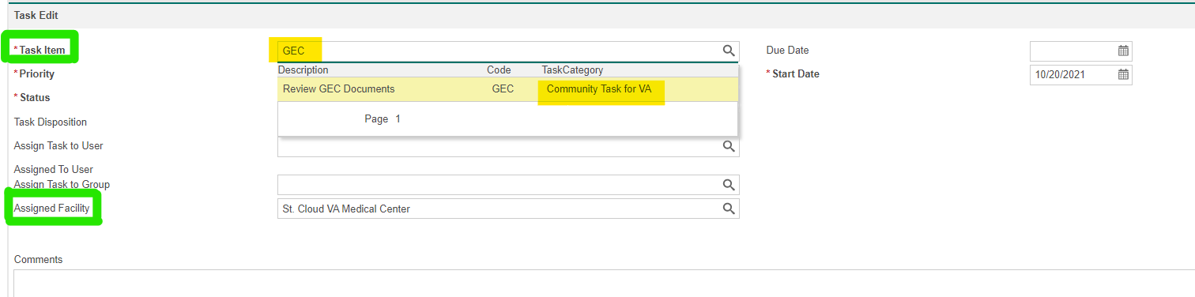
How to UPLOAD a document to HSRM Portal
Creating a Task:
In the “Task Item” box
  Type ‘GEC’ in the box
  Select “Review GEC Documents”
  Ensure that the Task Category states “Community Task for VA”
Ensure that the “Assigned Facility” states “St. Cloud VA
Medical Center” in the box.

Slide 26
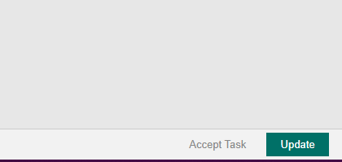
How to UPLOAD a document to HSRM Portal
Creating a Task:
Click “Update” button in bottom right corner of screen

Slide 27
Task List

Slide 28
What is the Task List?
This list will show you the documents that HCBC has
sent back to your agency.

Slide 29
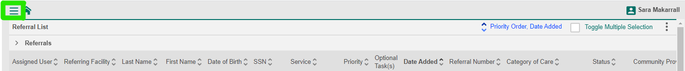
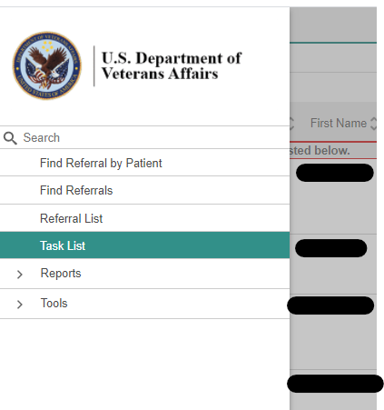
Where is the Task List?
You will click on the three horizontal LINES to the left of the house.
Then select “Task List” from menu.

Slide 30
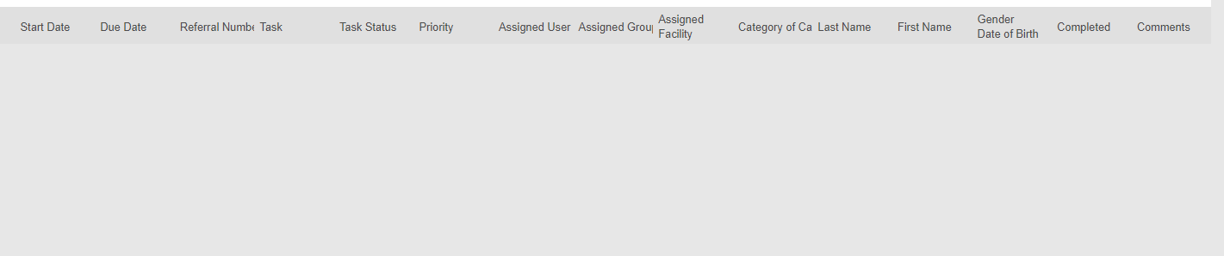
Where is the Task List?
If the screen is grey- nothing populates- then you do not have new documents that were sent the agency.

Slide 31
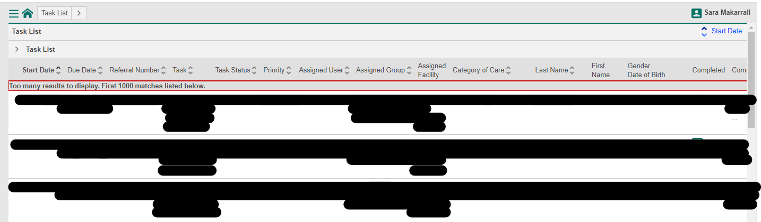
Where is the Task List?
If you have new documents, they will be listed individually.
Click on the task to view the new document.

Slide 32
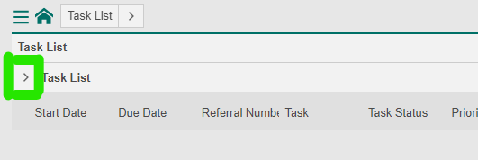
Task List Information
When a task is opened, the task will be removed from the Task List. In order to find the task back, you will want to search for completed tasks.
You will want to click on the > symbol to the left of the Task List sub-header.
  This will open an advanced search feature.

Slide 33
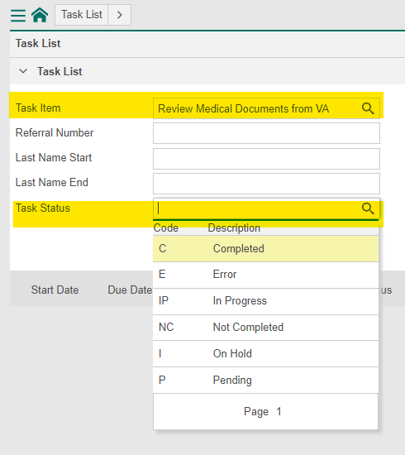
Task List Information
The “Task Item” type “review” and select “Review Medical Documents from VA”
Add “Task Status” of “Completed” by clicking on the magnifying glass

Slide 34
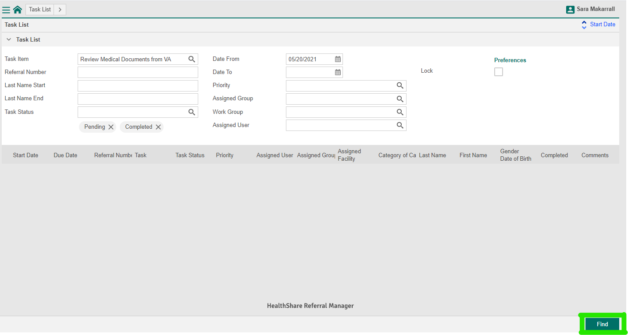
Task List Information
Then click the “Find” button in the bottom right corner.
The oldest task populates first

Slide 35
Download Document

Slide 36
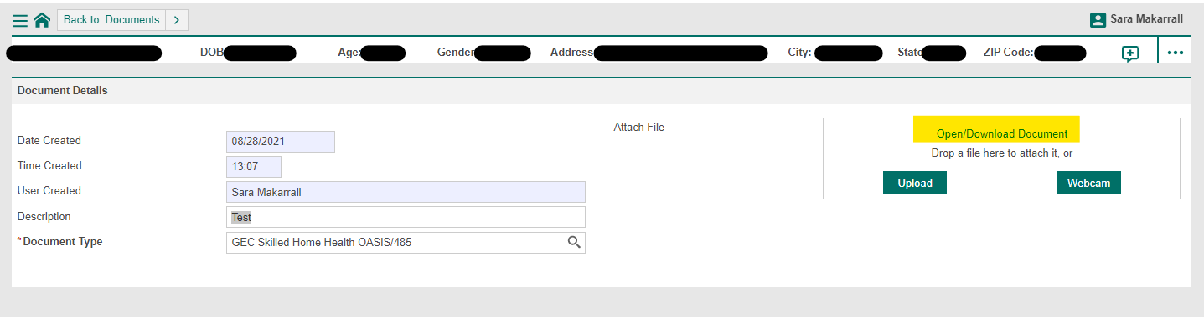
How to: Download Document
Select the document you wish to view from the Documents page- will only show 1 document if accessing through Task List or will show all documents if accessed through Referral Details page.
Click on “Open/Download Document”
The document will open in a new window, from which you can save/download from

Slide 37

HSRM Quicklinks
HealthShare Referral Manager Information Website:
https://www.va.gov/COMMUNITYCARE/providers/Care_Coordination.asp#HSRM
HealthShare Referral Manager Website:
https://ccracommunity.va.gov/
HealthShare Referral Manager Help Desk:
Phone: 844-293-2272
Email: HSRMsupport@va.gov

