Slide 1
Quality Star Ratings: How to Obtain the Rating You Deserve
MHCA Clinical Quality Team

Slide 2
Objectives
Increase awareness of Five-Star.
Offer tools to educate and enhance quality of care for Minnesota on the 9 performance measures and its impact.
To enhance Minnesota Five-Star scores.
Notes:
Question format…write down questions for later. And/or we can address answers on the website at a later date.
Talk about the starred slides can be pulled for agency leaders to use to present to their staff.

Slide 3
What is the Star Rating
CMS now publishes a 5 star rating for all Medicare certified home health agencies on Home Health Compare. This is part of CMS’ overall plan to adopt star ratings across all Medicare.gov Compare websites
Star ratings can help consumers more quickly identify differences in quality and make use of the information when selecting a health care provider.
Notes:
This is NOT the CAHPS star rating…that is a separate rating

Slide 4
What is the Star Rating
Referral sources, such as hospitals, clinics and insurance companies are starting to view Home Health STAR ratings to determine agencies to partner with for their patient populations.
These are promoting clinical best practices. Identify if your rating is related to inaccurate OASIS scoring or actual care/assessments being provided.

Slide 5
Why Does the Star Rating Matter?
Payment Reform
Value Based Payment
ACOs
Provider Incentive Programs
Others…
Agency Viability
Publically Reported Scores
More technology savvy Baby Boomers
Continuous Quality Improvement

Slide 6
Quality Episode
Start of Care or most recent Resumption of Care to Discharge/Transfer.
Example of one patient with 3 quality episodes:
SOC is 1/1/16 and Transfer is 1/14/16.
ROC is 1/18/16 and Transfer is 1/31/16.
ROC is 2/7/16 and Discharge is 2/28/16.
This only applies to the following payers:
Medicare or Medicare HMO
Medicaid or Medicaid HMO

Slide 7
How to review your rating
Home Health Compare
Casper Reports (in advance of public release)
Star Rating Preview Report
Monthly Outcome Report
Data Analytic Programs
Allows you to see real time data
Quality of Care Star Ratings Monthly Analysis. March 12,2016).
Notes:
Explain the data lag time and the amount of time it will take to see the results of your initiatives.
Data Analytic Programs: Home Health Gold, SHP, OCS HomeCare, now a part of the ABILITY network, PPS Plus (new owner), Others

Slide 8
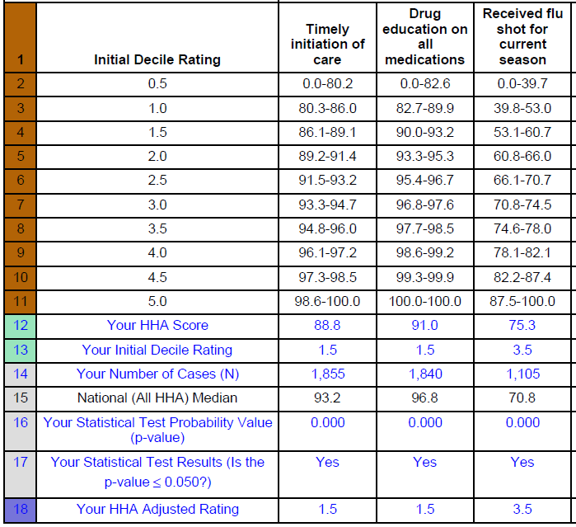
Sample Preview Report
Notes:
Speak to the report and how to read it…what to look for.
- describe this is released quarterly and what months the preview comes available.

Slide 9
Best Practices
Don’t tackle all 9 at once
Bottom performing measures
Middle performing measures that are close to the threshold
Process measures may be easier to improve than outcome measures
OASIS Training
All types of training (tip sheets, role play, formal education, simulation labs, co-visits)
Make training consistent and frequent
OASIS Resources
Provide clinicians with individual outcome data
Notes:
OASIS Resources examples: OASIS Answers, RCTC, Blueprint courses, Fazzi, etc.

Slide 10
Best Practices (cont)
OASIS Auditing
Frequent and Consistent
Real time auditing and feedback to clinician
Track trends
Individual
Branch or Team
Diagnosis / Clinical Condition
OASIS Item
Changing guidance (Q & A’s)
Staff Accountability
Notes:
Staff Accountability – key to success…agencies need to do this within their own group

Slide 11
Hints to Help the Auditor
Compare Plan of Care/Clinical Assessment and OASIS responses do they all agree??
Do the functional deficits match the therapy visits predicted?
Communication to staff
take personality out of the message stick to the facts
simply reference what is documented and how it presents inconsistency
Reference guidance materials and sources in the communication
Notes:
Compare the OASIS questions to each other. Example of inconsistent answers: patient needs supervision at all times on ambulation (3), and mark transfers independent (0)
Therapy might have good input related to the functional status. The assessing clinician is ultimately responsible.
If not documented it is not done!

Slide 12
Hints to Help the Auditor (cont)
Change the method of communication
Use words such as
“Consider”
“Relook”
“OASIS responses”
OASIS scored prior to the intervention not status at end of visit
Notes:
Method of communication – adapt to the individual…maybe a phone call is needed. Make it their idea instead of telling…ask more questions.
Consider…this implies that the auditor isn’t demanding or telling the clinician what to do.
Relook…at this record as there are inconsistencies in documentation…”
OASIS Responses…should indicate ongoing need therefore if responses are at the top of the scale an auditor might question what is the ongoing need demonstrated for this case or how is this patient home bound.

Slide 13
Hints to help the Auditor (cont)
Hints to address feedback from staff
Medicare provided us the OASIS data set to demonstrate our quality performance.
This is mandated by Medicare and this is how ALL agencies are measured.
Since ALL agencies use the same tool we must maximize this tool.
Give both positive and constructive feedback
Notes:
If staff seem hesitant, defensive or resistant to feedback or suggestions….
Remember OASIS is simply a data collection tool…staff need frequent reminders of this!
CMS has given us direction on how to answer the questions…even it doesn’t make sense to the clinical mind.
Give positive and constructive feedback…
Some agencies have staff do peer audits….

Slide 14
Measures Included
Process Measures
Timely Initiation of Care
Drug Education on all Medications Provided to Patient/Caregiver
Influenza Immunization Received for Current Flu Season
Outcome measures
Improvement in Ambulation
Improvement in Bed Transferring
Improvement in Bathing
Improvement in Pain Interfering With Activity
Improvement in Shortness of Breath
Acute Care Hospitalization
Notes:
Introduce the next grouping of slides.
Remind the audience that we have provided handouts related to these measures to include general tips.

Slide 15
Timely Initiation of Care
What our agency is doing
Common indicators for low score
Referral date entered in error
Physician ordered SOC date not entered
SOC process
Lack of utilizing two-day admission process
Software challenges
Staffing challenges

Slide 16
Drug Education on all Medications
What our agency is doing:
Common indicators for low score
Clinicians misread the question
Not taking credit for education provided by ANY agency staff
Not considering education done at the discharge visit or by other providers
Inconsistent documentation
Notes:
Auditing specifically the therapy discharges and education…
Assisted livings can be a challenge to work with on this…work on openly communicating with them about our need to see the patient’s actual medications.
Education can be done over the phone!
Other providers…physician, nurse practitioner, pharmacist…

Slide 17
Influenza Vaccination Received
What our agency is doing
Common indicators for low score
Lack of research
Misread the question / ignoring the date range guidance
Notes:
Our agencies (Accra, Knute) are using the MIIC MN immunization influenza information connection to get this information (a tool to find out if the patient has received their influenza vaccination.
Define date range criteria…(October thru March)
These indicators are going to be some of the same issues with the PPV question.

Slide 18
Functional Items – General Tips
Do not assume – see the patient move
Consider last 24 hours
Consider ability, not willingness
Do not consider caregiver availability
Rate before intervention provided
Notes:
For all functional items – specifically Ambulation, Bed Transfers, Bathing
Plug the OASIS Cornerstones Video done by the rehab team…

Slide 19
Improvement in Ambulation
What our agency is doing
Common indicators for low score
Not observing the patient actually walk
Not considering safety
Rating score after intervention or based on the device patient uses
Considering lack of caregiver as a reason to score patient independent
Notes:
Have therapists communicate with the RN related to functional items that they witnessed in the home. Build relationships between the therapy and nursing staff.
Observation of the functional abilities from the start of the visit.
Consider all of the item guidance in OASIS answers

Slide 20
Improvement in Bed Transfers
What our agency is doing
Common indicators for low score
Not observing the patient actually transferring
Not considering ambulation as a part of transferring (in most cases)
Not considering safety
Rating score after intervention or based on the device patient uses
Considering lack of caregiver as a reason to score patient independent
Notes:
Re-education to staff about what this items includes and the complexities / tricks to the wording
Safety considerations: Homemade equipment!

Slide 21
Improvement in Bathing
What our agency is doing
Common indicators for low score
Not observing the bathroom set up and patient actually perform transfer into bath/tub
Assuming help from family is safe and consistent
Not considering safety / equipment needed
Discharge assessed on willingness vs. ability
Notes:
One agency is doing: Admit nurse is actually getting the patient into a shower and integrating the other assessments within this routine.
Another agency has implemented a “Better breathing” program…which is enhancing the education that the patient receives and improves patient’s management of their breathing.

Slide 22
Improvement in Pain Interfering
What our agency is doing
Common indicators for low score
Misread the question
Lack of understanding the definition of “pain interfering”
If the pain medication regimen at discharge is successful, then it may not interfere with activity
Not considering all activities (i.e. sleep, watching TV)
Underscored at SOC
Notes:
Multi-disciplinary team to give hints on how to read/answer the question…
Education on the communication portion of the question
SOC – 24 hours could include when they were still in the hospital on pain medication. Also – patients may be avoiding activities because of fear of pain, so they don’t really know if pain is interfering.
The patient’s treatment for pain (whether pharmacologic or non-pharmacologic) must be considered when evaluating whether pain interferes with activity or movement. Pain that is well controlled with treatment may not interfere with activity or movement at all.

Slide 23
Improvement in Shortness of Breath
What our agency is doing
Common indicators for low score
Not getting the patient out of the chair to see what elicits SOB
Understanding the guidance regarding oxygen
Not considering all contacts with patient/opportunity for assessment
Notes:
Kristy’s example of the bathroom…admit nurse should take the patient to the bathroom during admit
Patient short of breath over the phone?

Slide 24
Acute Care Hospitalization
Reach out to community partners for collaboration across settings
Local / Regional / National
What our agency is doing
Notes:
Look at if the re-hospitalization is related to the diagnosis the patient is being seen for. Assess for accuracy of the OASIS item so that reports can be accurate and the top reasons could be addressed. - The OASIS reason is often answered “other”
EX: SOB is the common reason – do staff (on call) need additional education on management of SOB symptoms? Do patients need additional education to call agency first?
Front loading visits / phone calls / technology – some agencies are also trying to extend the LOS to impact these rates (front loading isn’t enough when we are responsible for 60 days). NOTE: according to Ability demo, MN has an average length of stay that is shorter than national average.

Slide 25
Tools & Resources
RCTC Education
OASIS Answers
CMS Process-Based Quality Improvement Manual
https://www.cms.gov/Medicare/Quality-Initiatives-Patient-Assessment-Instruments/HomeHealthQualityInits/downloads/HHQIOASIS-PBQI.pdf
CMS Outcome-Based Quality Improvement Manual
https://www.cms.gov/Medicare/Quality-Initiatives-Patient-Assessment-Instruments/HomeHealthQualityInits/Downloads/HHQIOBQIManual.pdf
Pressure Ulcer Guidance Manual
Clinical Quality Team Tools
Monthly Articles
OASIS Cornerstones Video
MHCA Rehab Team

Slide 26
References
Quality of Care Star Ratings Monthly Analysis. (2016, March 12). Retrieved March 12, 2016, from https://connection.ocsgateway.com/

Slide 27
Questions?
Notes:
General overview – good luck
Thanks for coming!

