Slide 1
Agenda
Community Care Network (CCN)
Overview of changes to home care
Health Share Referral Manager (HSRM)
Resources

Slide 2

Home care agencies partner with the VAMC
Providing High Quality, Timely Care to Veterans
Notes:
VA provides care to Veterans through community providers when VA cannot provide the care needed. Home care agencies are a vital part of VA’s high-performing health care network, ensuring eligible Veterans and their beneficiaries get the timely, high-quality health care they need!
Thank you for being a part of our network!
Source of image: https://www.bing.com/images/search?view=detailV2&ccid=PHnE%2fxjn&id=FF7C59E6419F6F21E0FC2727DC2E44167BBA2AD8&thid=OIP.PHnE_xjn4n64I5SKAQEJigHaE7&mediaurl=https%3a%2f%2fwww.northcountrypublicradio.org%2fnews%2fimages%2fhomehealthaide_CC.jpg&exph=681&expw=1024&q=creative+commons+images+of+home+health&simid=608000737154827738&ck=29D73C9F99A277FA5B5FC6CD7AD9DB8F&selectedIndex=1&qpvt=creative+commons+images+of+home+health&ajaxhist=0

Slide 3

Community Care Network: TPA=Optum
VISN23 System Redesign
HSRM
Notes:
Training will discuss
Transition to the Optum, the third-party administrator for the Community Care Network (CCN)
Overview to changes in home care as a result of the system redesign workgroup. Implementing the use of the consult template (agencies will not see effect of this change) but will note the second change: implementing the VHA Purchased Home and Community-Based Services case mix (CM) tool across all the VA medical centers in the Midwest Healthcare network.

Slide 4
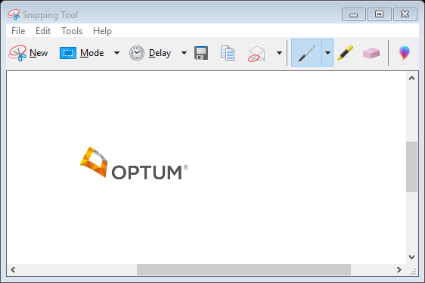
Community Care Network (CCN): Optum
Veterans choose
  Providers in CCN - Optum is TPA
  Veterans Care Agreements (limited)
To Join CCN
  UHCprovider.com > Join
  Optum Call (844) 839-6108 (8am to 8pm ET, Monday through Friday, excluding holidays)
  Optum provider portal
    View claims
    Training
Notes:
CCN is part of VA’s modernization efforts, which have new requirements that emphasize transparency, accountability, quality, and increased communications between VA, providers, and Veterans to improve Veterans' access to care. OPTUM, the TPA selected for our region will administer CCN with transparency, accountability, quality and in accordance with the enhanced requirements of the contract.
VA is responsible for handling customer service for Veterans:
VA directly manages Veteran community care customer service touchpoints while the CCN Regional TPAs will support inquiries from community providers and VA.
Optum is committed to processing 98% of all clean claims within 30 days. Clean claims are
claims received with all the required data elements necessary for a successful EDI transaction,
as well as all required fields for VA CCN.
VA Medical Centers (VAMCs) can purchase care in the community for eligible Veterans, after VA options to render the care have been considered, under multiple programs. There is a hierarchy for Care Purchased: We strive to use the VA when care can be provided there. If the VA is not available the Department of Defense or other Federally contracted facility would be the next purchasing authority used; then a provider from the Community Care Network (CNN) - National Contract; then local Contract with approved waivers may be used and then Veterans Care Agreements.
If change in payment source- E.g., from VCA to Optum- dc and readmit

Slide 5
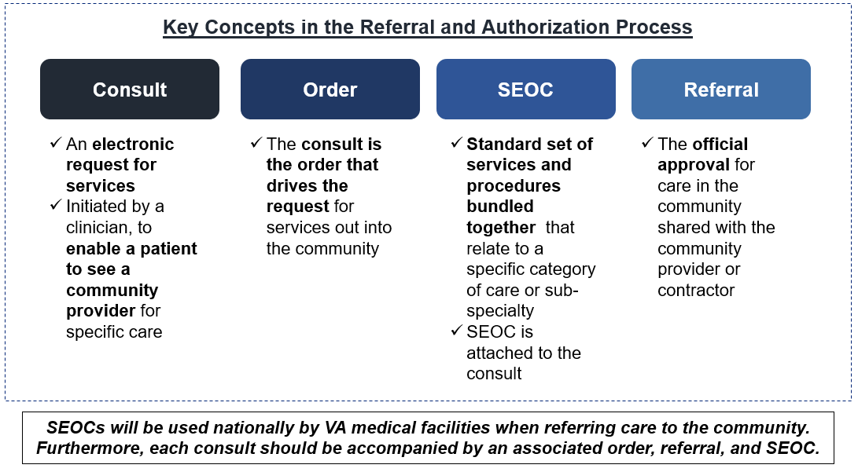
Referral and Authorization
Notes:
Many of you are already familiar with the Referrals and authorization process that are part of the VA. Today, we want to give you a “behind the scenes” look at the process the VA goes thru before you get a referral from the VA authorizing you to see a Veteran. The first step is that a VA provider or authorized VA community care provider creates an order for the home care. As we already discussed the Veteran’s eligibility is reviewed along with the order and a Standardized Episode of Care or SEOC is applied to it. Think of the SEOC as a broad authorization – Each SEOC corresponds with a set of codes that can be authorized and paid by Optum. The role of the SEOC is to state the maximum services that could be approved if the Veteran has the clinical need for that care. Be aware that the consult order written by the VA provider is what should drive the care you provide to the Veteran and any care should be given within the parameters of these orders. Any changes or updates made to the plan of care must be approved and authorized by the VA. One of the reasons the SEOCs are used is to lessen the administrative burden and to ensure continuity of care. We will discuss this more as we go through the rest of the presentation
Home care should always be preapproved by the VA, so if care is needed beyond what has been ordered, you must request approval from the VA community care team (we will cover more on this in a few minutes).

Slide 6
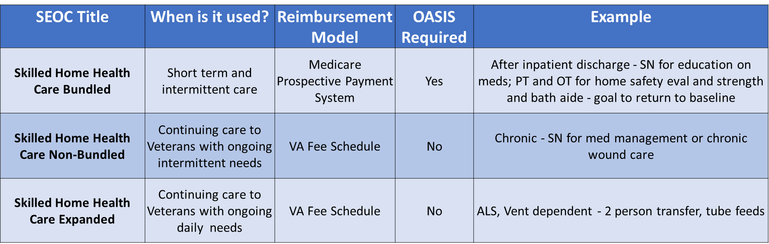
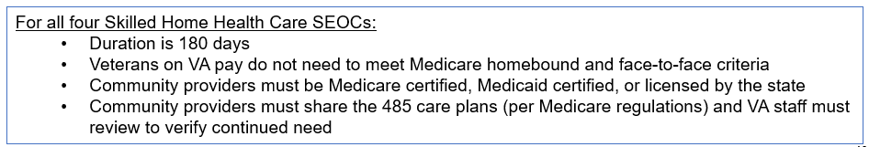
Skilled Home Health Care SEOCs
Notes:
As we discussed previously, each consult will have a standardized episode of care (SEOC) applied to it. Let's talk a bit about the SEOCs and how they correspond to the VA Office of Community Care approach to home care.
Skilled Bundled- This is short term acute care like someone who went inpatient for hip surgery and now needs home care to get back to baseline. Bundled follows Medicare guidelines for completing the treatments plan/OASIS… Bundled care is sent to Medicare certified agency who can do OASIS and get the HIPPS code (1IA31)/case mix adjustment for payment. If your agency cannot do an OASIS- then you cannot accept bundled SEOC. Review SEOC assigned when called for scheduling prior to accepting referral. Review offline referral form packet to assure right SEOC was applied.
Skilled nonbundled: this is for long term chronic care... like "Medicaid" if you will. This is reimbursed via VA fee scale. Examples include catheter changes monthly, med mgmt monthly, etc. For nonbundled SEOCS the VA does not require the completion of an OASIS. Note- while the VA may not require an OASIS, specific agencies may continue to complete this. Note- med mgmt. only needs a clinical indicated reason i.e. cognition issues, complex med regimen, dexterity issues- these MUST be documented for ongoing authorization in nursing notes.
Skilled expanded SEOC- "private duty nursing" if you will.

Slide 7
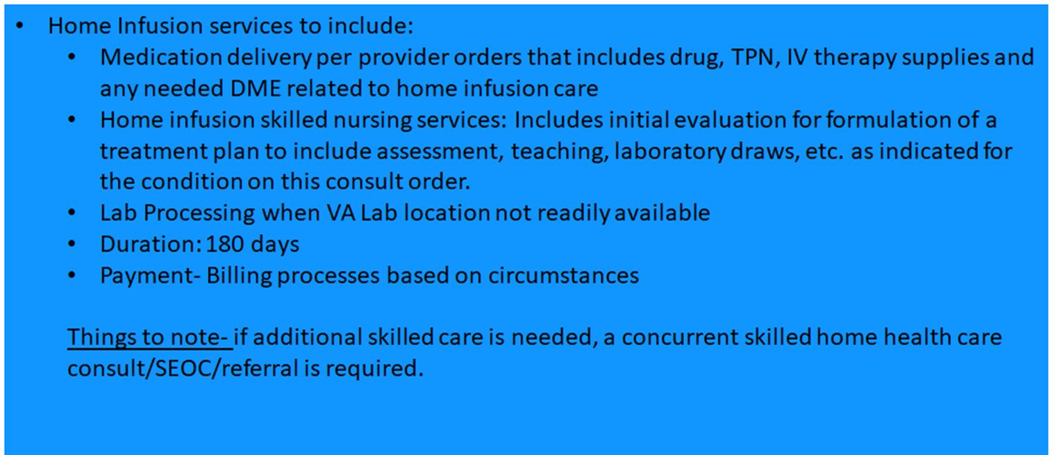
Home Infusion SEOC
Notes:
Home infusion SEOC is another skilled SEOC- covers the infusion therapy plus a few SN visits. Please note if your home infusion agency that you routinely use may only allow 1-2 SN visits with this SEOC…. They say the reimbursement rate is terrible…. So if more visits are needed, another skilled consult/SEOC/referral may be needed. Does that make sense? Or if say the SN gets out there and vet cannot be taught and agency needs to do a daily infusion then for sure another skilled consult assigned bundled SEOC will be needed.
“If a patient receiving home infusion therapy is also under a home health plan of care, and receives a visit that is unrelated to home infusion therapy, then payment for the home health visit would be covered under the Home Health Prospective Payment System (HH PPS) and billed on the home health claim.
When the home health agency furnishing home health services is also enrolled as the qualified home infusion therapy supplier furnishing home infusion therapy services, and a home visit is exclusively for the purpose of furnishing items and services related to the administration of the home infusion drug, the home health agency would submit a home infusion therapy services claim under the home infusion therapy services benefit.
If the home visit includes the provision of other home health services in addition to, and separate from, home infusion therapy services, the home health agency would submit both a home health claim under the HH PPS and a home infusion therapy services claim under the home infusion therapy services benefit. However, the agency must separate the time spent furnishing services covered under the HH PPS from the time spent furnishing services covered under the home infusion therapy services benefit.
If the qualified home infusion therapy supplier is not the same entity as the home health agency furnishing the home health services, the home health agency would continue to bill under the HH PPS on the home health claim, and the qualified home infusion therapy supplier would bill for the services related to the administration of the home infusion drugs on the home infusion therapy services claim

Slide 8
Case Mix – Personal Care Services
The VHA Purchased Home and Community-Based Services case mix (CM) tool
Standardized tool
Determine amount of care needed for Non-skilled needs
  Implementing use in all VA Medical Centers in Midwest Healthcare network
Notes:
To receive Nonskilled care:
Administrative eligibility- enrolled in VA healthcare, and has a VA provider who will order and oversee the home care services.
Case mix shows the Clinically eligibility:
Three or more activities of daily living (ADL) dependencies OR
Significant Cognitive Impairment OR
Require Nonskilled services as an adjunct to Home Hospice Care OR
Two ADL dependencies AND two or more of the following conditions:
Dependency in three or more instrumental activities of daily living (IADLs)
Recent or upcoming discharge from a nursing home
75 years old or older
High use of medical services (3 or more hospitalizations in the last year or 12 or more outpatient clinic or ED visits in the last year)
Diagnosis of clinical depression
Lives alone
Note: If the eligibility criteria above are not met, but the clinical care team determines the Veteran requires homemaker/home health aide (HMK/HHA) care, the service may be authorized but the reasons for the variance must be documented in the clinical record by the ordering provider.
Authorization:
VA provider determines need for nonskilled, VACC then completes the CMT- mirrors the OASIS questions ( bathing, transfers, grooming, dressing, behavior and some neuro diagnosis)
CMT is completed annually, change in condition.
If concerns that level of care needed was not captured by the case mix tool; contact the VA to discuss special circumstances

Slide 9
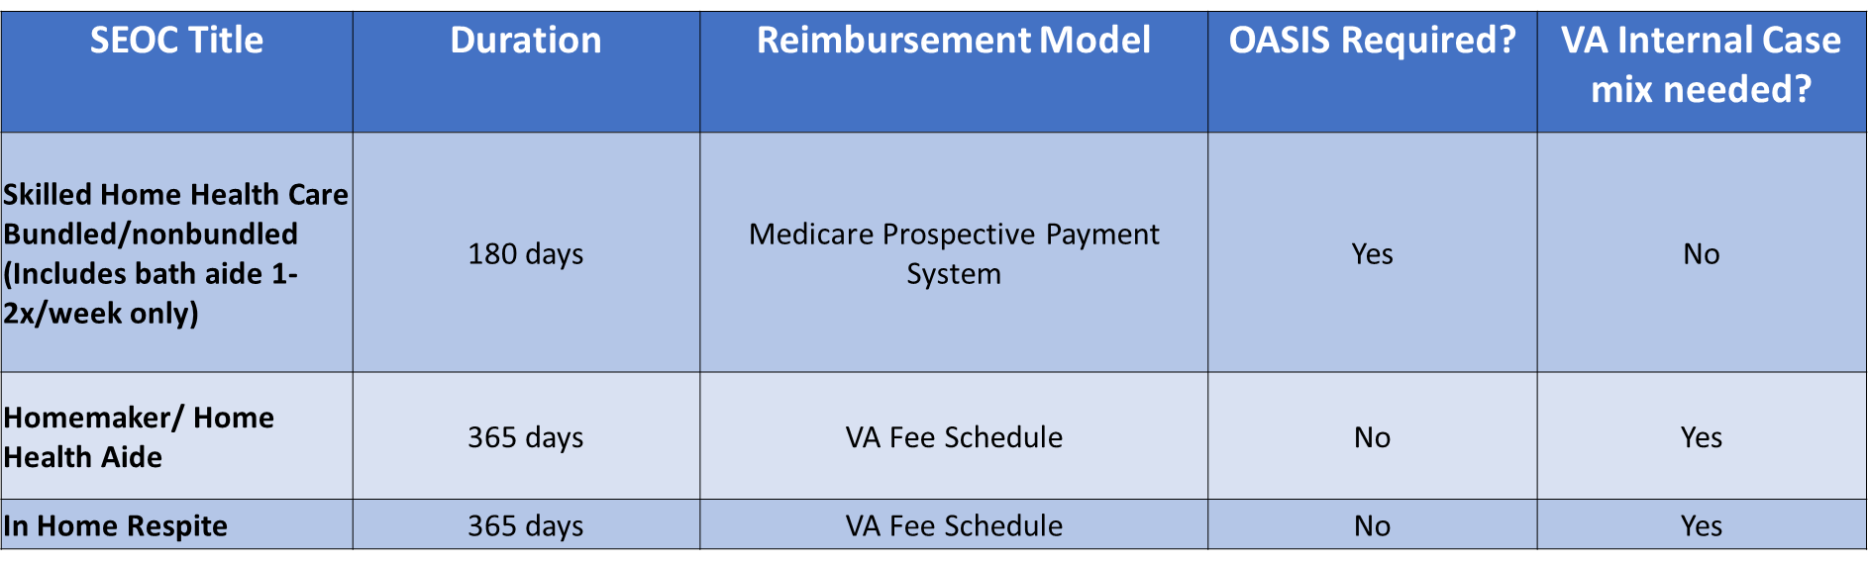
Personal Care Services SEOCs
SEOC’s now include RN oversite visits
Target population is Veterans in need of nursing home care with 3+ activities of daily living deficits or cognitive impairment
Personal Care Services Case Mix Tool is required
VA case mix needed at initiation of care, annually and significant change in condition
Notes:
Personal care Services SEOCs are as follows:
Remember skilled bundled and nonbundled comes with aide 1-2 times/wk only!!! If more are needed then we go into having to complete the CASE Index tool and assign separate auth to it. These SEOCs are reimbursed on fee schedule.
Recent updates include- SEOC duration from 180 days to 365!!! Update oversight visits from 8 to 16. A separate skilled auth is no longer needed for oversight if no skilled service is needed.
Awarded a SEOC based on CMT. If agency feels it doesn’t match what is authorized VACC conversation, RFS can be completed and documented with new CMT completed to see if qualifies for increased services/hrs.

Slide 10
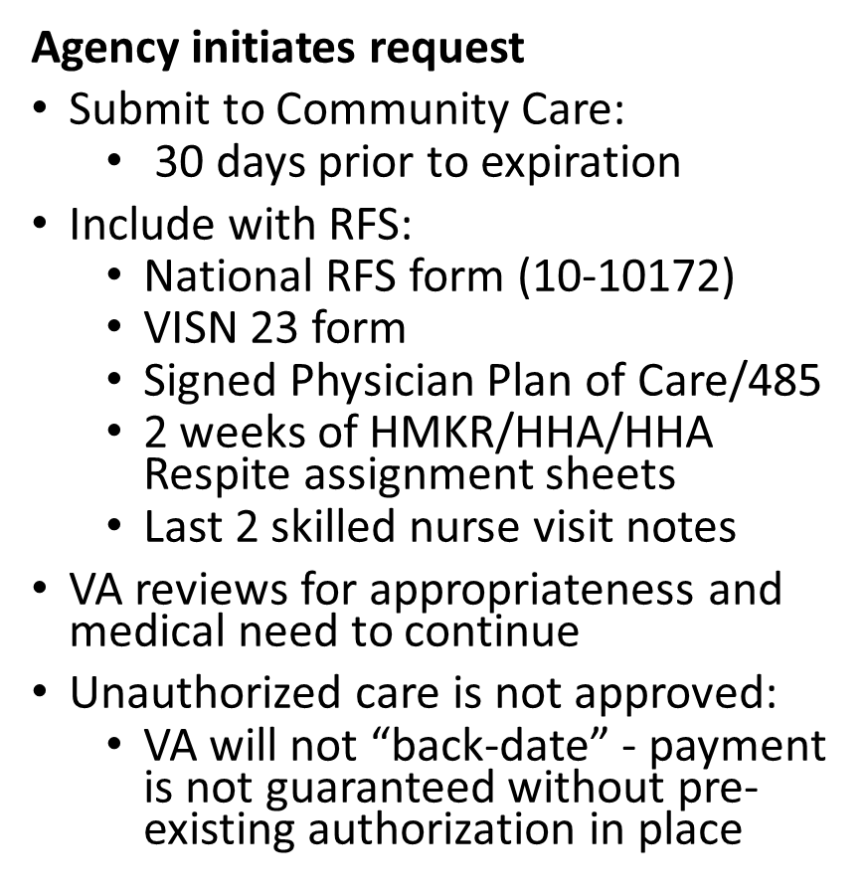


Reauthorizations – send RFS
Notes:
The use of the RFS form is required for reauthorization requests to facilitate review and authorization. All supporting medical documentation must accompany the completed form. If additional information is needed to authorize the request, the community provider will be contacted.
A blank RFS Form will be sent with all referral packets. To complete the RFS, fill-out the information and indicate the type of service (s) being requested.

Slide 11
HealthShare Referral Manager (HSRM)
HSRM is VA’s new secure online portal for managing referrals and authorizations
Standardized referrals
Facilitates health information exchange
Track's healthcare delivery
Allows community provider to submit Requests for Services (RFS)
Notes:
HSRM is the system the VA now uses to generate and submit referrals and authorization to community agencies. HSRM will allow community providers and VA to better manage community care for Veterans. The system’s robust functionality facilitates reduced turnaround time for processing referrals, providing care, submitting claims, and receiving payment. Registration, training, and technical support for HSRM are available to community providers at no cost!
Benefits
•Fosters health information exchange (HIE) between VA and community providers through one unified platform
•Promotes reduced turnaround time for authorizations and reimbursement
•Provides easy access to bundled care/standardized episode of care (SEOC) details
•Indicates which services are required and how to acquire precertification when necessary
•Reduces time wasted waiting for fax, phone, or email contact prior to serving a Veteran
How to Access HSRM
If you are interested in using HSRM, confirm your facility meets the following criteria:
Your facility has an active network agreement (i.e. Community Care Network (CCN), TriWest) or Veterans Care Agreement (VCA) with VA.
A point of contact from your facility has reached out to the Community Care Point of Contact at the VA Medical Center(s) you partner with to:
Confirm that your facility’s specialty can be processed in HSRM
Request the exact facility name/location on the Provider Profile Management System (PPMS) record for your National Provider Identifier (NPI) numbers
Obtain concurrence to move forward with HSRM at this time
Prerequisite activities to use HSRM:
1. Attend training webinar on VHA Train
2. Create ID.me account
3. Submit an end user tracker
Mondays 2-4 p.m. ET Tuesdays 1-3 p.m. ET
Community providers will learn about the background and purpose of HSRM and its full functionality
Community Provider Registration
Wednesdays 3:30-4 p.m. ET
Community providers will learn how to register for HSRM.

Slide 12
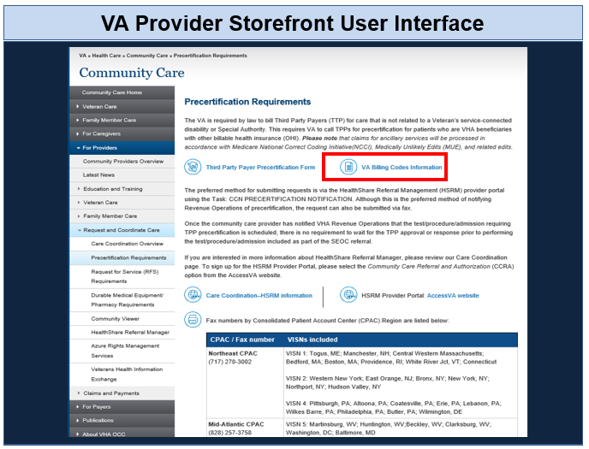
CPT Codes and Billing information
The VA Provider Storefront
VA Webpage -Public domain
accessible by community providers
Look up CPT Codes for Active SEOCs
VA Fee Schedule
Notes:
Some codes from the home care SEOCS will require precertification. E.g., skilled RN + infusion SEOC
What is Changing: VA is updating its fee schedule calculations to align with industry best practices and will now calculate the payment rate based on the location where the care is provided (i.e. rendering locality). Previously, the VA fee scheduled calculated the payment rates based on the location of the referring VA Medical Center.

Slide 13
Community Care
For questions, please contact:
Minneapolis Community Care Dept
  Phone: 612-725-8196
  RFS Fax: 612-794-3982
If needed:
  Amber Hoelscher, ANM 612-725-8120
  Amber.Hoelscher@va.gov
  Jessica Davidson, ANM 612-725-8116
  Tara Larive, NM 612-725-8041

Slide 14
Resources
Links to Optum
VA website for community providers
  Care Coordination Overview
  HSRM
  VA Fee Schedule
HSRM Community Provider Information Sheet
VA third party payor precertification form
Veteran facing: VA Home & Community Based Services
RFS (VA form 10-10172 May 2019)
Fargo Reauthorization Form

